Slide 1
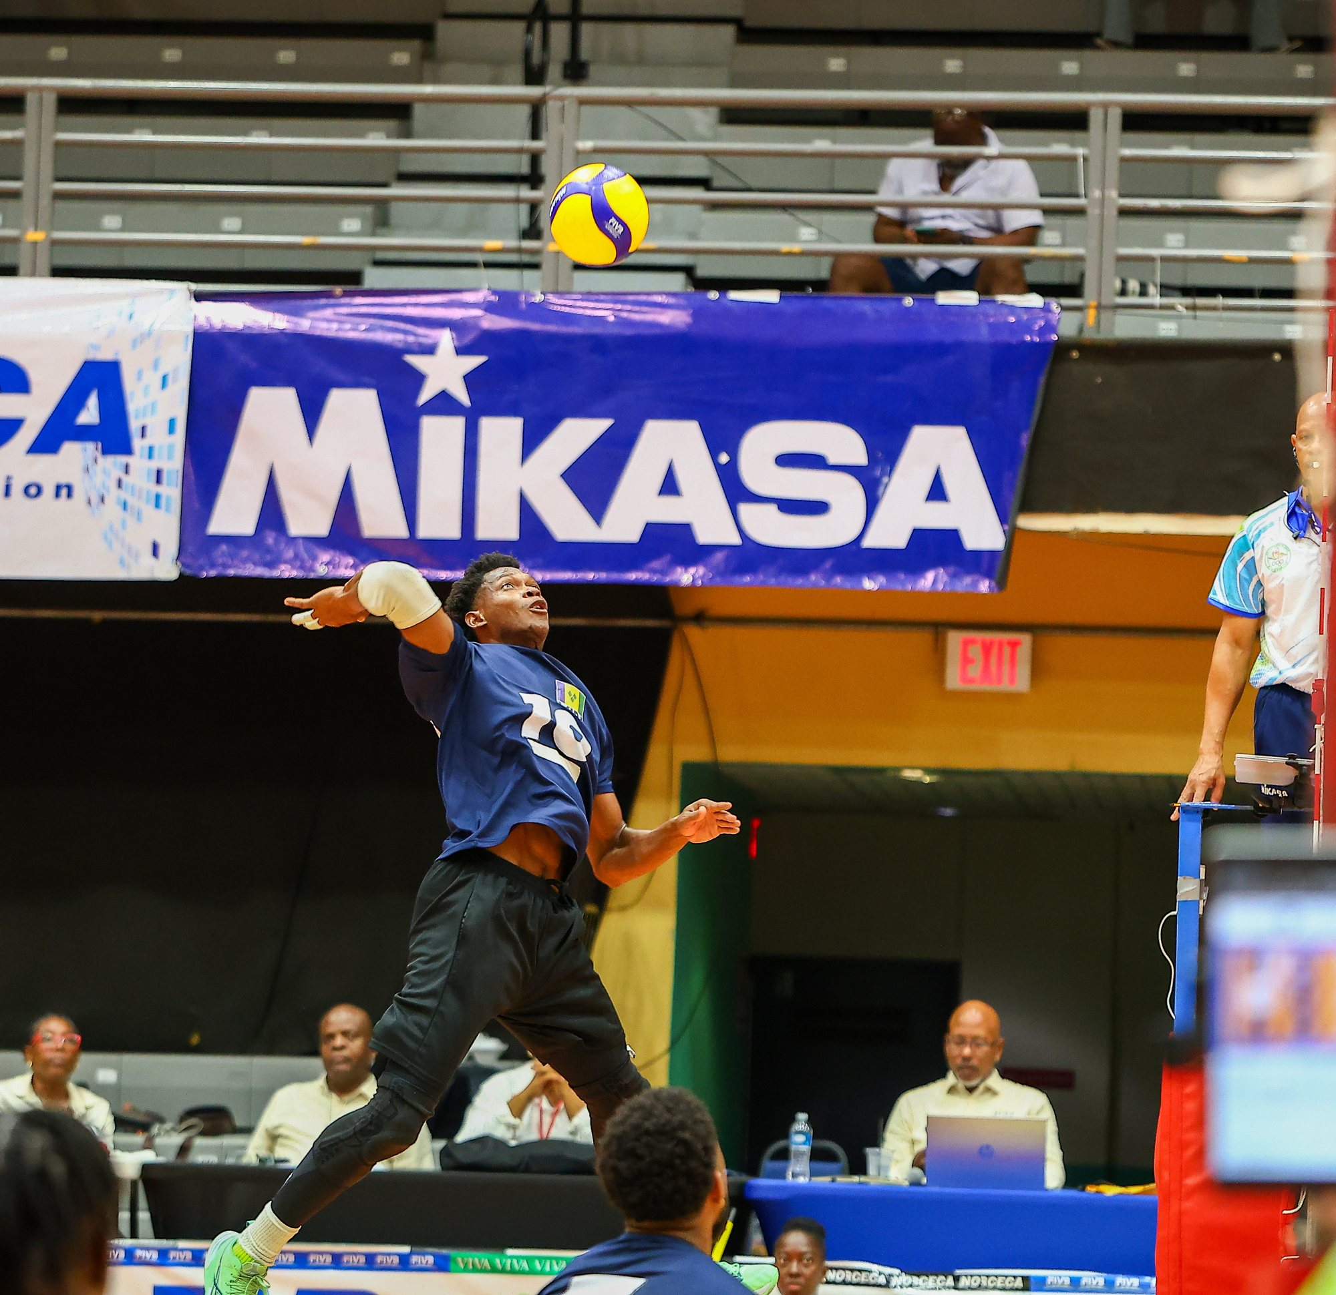

EASTERN CARIBBEAN VOLLEYBALL ASSOCIATION
President's Report
January 2025 – September 2026
Glenn Quinlan
President, ECVA
ECVA Annual General Meeting · NORCECA General Assembly
Notes:
President's Report covering the full 2025 calendar and the 2025–26 reporting period (1 October 2025 – 30 September 2026), for the ECVA Annual General Meeting (December 2026, Sint Maarten) and the biennial NORCECA General Assembly. Cover photo: 2026 ECVA Senior Championships, Tortola (10 Pictures & Media/2026/Senior Indoor - BVI/KE4A416601.jpg).

Slide 2





Two full seasons across the zone
2025–2026 AT A GLANCE
8
9
US$618K
championship events
coach and referee courses
NORCECA investment, 2025
13 men's and women's competitions
Plus a training camp, Athlete365 workshop and seminars
Audited: NORCECA Audited Report 2025
8
US$280K
100%
federations won medals
FIVB and Olympic Solidarity, 2026
of 2025 matches streamed live
39 medals across 13 competitions
Empowerment US$240K · Olympic Solidarity US$40K
Plus 31,967 Twitch live views in 2026
ECVA was founded on 3 March 2007 in St. John's, Antigua, and today unites 14 member federations as a zone of the NORCECA Volleyball Confederation.
Notes:
2025: Senior Beach, U21 Beach, Men's Final 4, Women's Final 4 and U23 Men's (7 competitions); 2026: Senior Beach, U20 Beach, Senior Indoor (6 competitions). Courses: 2025 beach coaches course, beach referees course, indoor referee seminar; 2026 FIVB beach coaches course, advanced beach coaches seminar, national and international beach referee courses (St. Kitts), BVI national referees course and FIVB Level 1 coaches course. Medal count compiled from all 13 podiums. NORCECA 2025 investment US$618,450.41 (NORCECA Audited Report 2025). FIVB Empowerment US$240,000 and Olympic Solidarity US$40,000 as advised by the President. Every match of every 2025 event was streamed live (2025 President's Report); 2026 Twitch figures from the ECVA 2026 Technical Report. Founding and membership: ecvolleyball.com/about.

Slide 3





NORCECA's investment in ECVA
OUR LARGEST PARTNER
US$618,450.41
NORCECA SUPPORTS
Every ECVA championship
Total NORCECA investment in ECVA, 2025
Every ECVA course
As reflected in the NORCECA Audited Report 2025, available on the NORCECA website.
Every team on the NORCECA beach tour
2025 EVENT SUPPORT INCLUDED
US$85K
US$15K
US$15K
US$15K
The ECVA website
Final 4, men and women
Senior Beach
U21 Beach
U23 Men's
Technical team and VIS equipment
Plus up to US$700 per athlete for NORCECA Beach Tour participation.
2026: figures will follow NORCECA's audit after 31 December 2026; unaudited figures have been requested.
Notes:
NORCECA's total investment in ECVA for 2025 was US$618,450.41, as reflected in the NORCECA Audited Report 2025, available on the NORCECA website (email from NORCECA President Cristobal Marte Hoffiz, 29 October 2026). 2026 figures await NORCECA's audit after 31 December 2026; the President has requested unaudited 2026 figures. NORCECA supports every ECVA championship, every course, every team participating in the NORCECA beach tour, the ECVA website, and the equipment for the technical team and VIS. 2025 event support listed in the 2025 President's Report: US$15,000 Senior Beach; US$15,000 U21 Beach (co-shared with IOC/FIVB support); US$85,000 Final 4 men and women (including airline tickets and host support); US$15,000 U23 Men's; up to US$700 per athlete for NORCECA Beach Tour participation.

Slide 4
The 2025 season: eight major activities
2025 CALENDAR
2–4 May
Senior Beach Championships, men and women
Saint Lucia
1–6 June
FIVB Beach Volleyball Coaches Course
St. Kitts and Nevis
4–8 June
National Beach Volleyball Referee Course
St. Kitts and Nevis
6–8 June
U21 Beach Championships, men and women
St. Kitts and Nevis
11 September
General Meeting: FIVB Empowerment Platform training
Member federations
19–21 September
Men's Final 4 (first edition)
Antigua and Barbuda
26–28 September
Women's Final 4 (first edition)
Antigua and Barbuda
Oct–Nov
One-on-one consultations with member federations
Virtual
November
Indoor Referee Seminar, eve of the U23 championship
Antigua and Barbuda
12–16 November
U23 Men's Indoor Championship
Antigua and Barbuda
11–14 December
NF Development Workshop and Annual General Meeting
St. Kitts and Nevis
Championship
Course or seminar
Governance or support
Notes:
Source: 2025 President's Report (14 December 2025). Referee course dates 4–8 June 2025 per the ECVA 2025 Referee Commission Report. U23 dates confirmed as 12–16 November 2025 from match reports on norceca.info; the 2025 report's October dates were incorrect. The Indoor Referee Seminar was held the day before the U23 championship began. Final 4 dates from norceca.info.

Slide 5
The 2026 season: competition with education
2026 CALENDAR
1–3 May
Senior Beach Championships, men and women
Saint Lucia
6–10 July
FIVB Beach Volleyball Coaches Course
St. Kitts and Nevis
7–8 July
Advanced Beach Coaches Seminar
St. Kitts and Nevis
7–9 July
Athlete Training Camp (light sessions 9 July)
St. Kitts and Nevis
7–8 July
Athlete365 Career+ Workshop (SKNOC)
St. Kitts and Nevis
7–12 July
International Beach Referee Course
St. Kitts and Nevis
8–9 July
National Beach Referee Course
St. Kitts and Nevis
10–12 July
U20 Beach Championships, men and women
St. Kitts and Nevis
21 Jul – 16 Aug
ECVA National Referees Course
British Virgin Islands
12–16 August
Senior Indoor Championships, men and women
British Virgin Islands
17–21 August
FIVB Level 1 Coaches Course
British Virgin Islands
September
Support for the men's U23 Pan American Cup
El Salvador
December
Annual General Meeting
Sint Maarten
Championship
Course or seminar
Governance or support
Notes:
Source: ECVA Report of Activities, 1 October 2025 to 30 September 2026 (FSRC revised). AGM scheduled for December 2026 in Sint Maarten. The advanced beach coaches seminar closed with a certificate ceremony on 10 July. Athletes and coaches not on the FIVB coaches course arrived Monday 6 July. The Training Camp (Rick Bevis) ran Tuesday–Wednesday 7–8 July with light sessions on Thursday 9 July; the Advanced Beach Coaches Seminar ran 7–8 July in concert with the camp; the Athlete365 Career+ Workshop (Hazel-Ann Regis-Buckels, SKNOC) was also held 7–8 July.

Slide 6
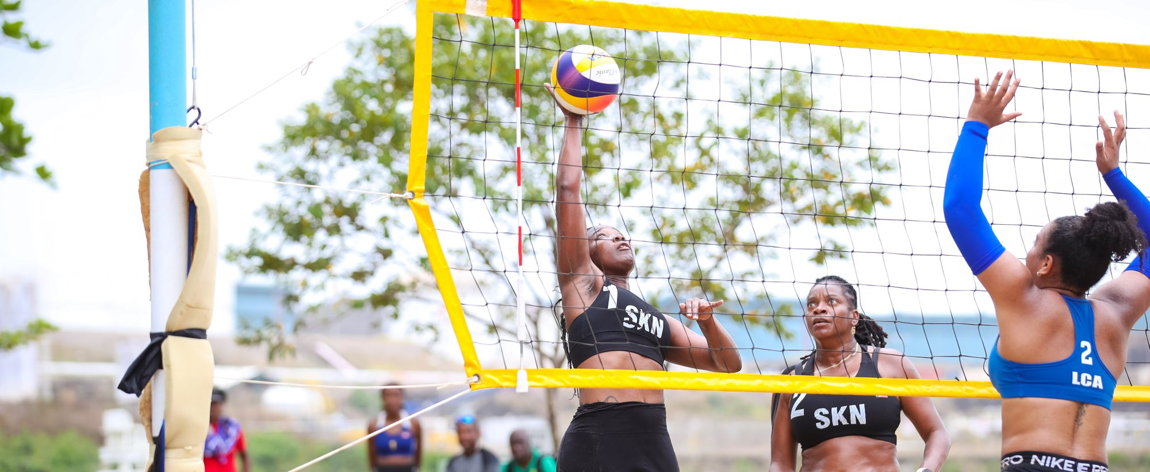
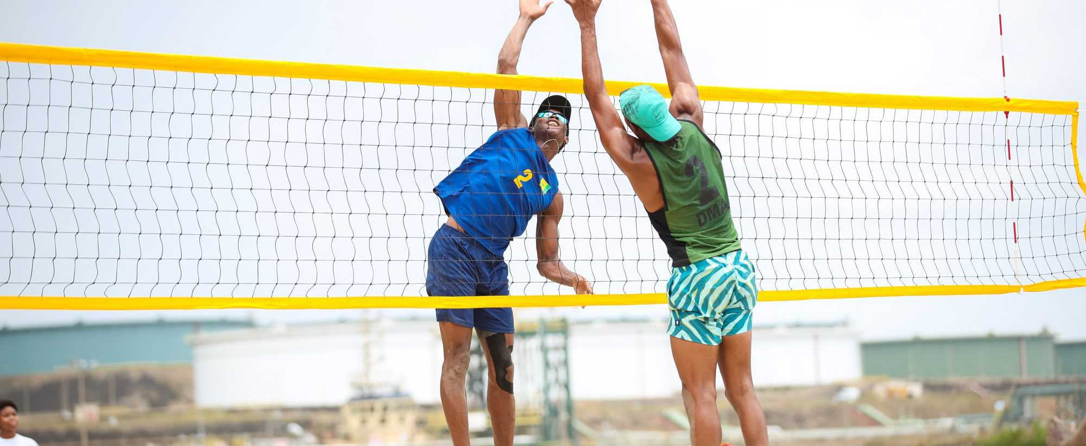
Senior Beach Championships 2025, Saint Lucia
2025 SEASON · MAY
WOMEN Champions: Gumbs / Dyer (SKN)
MEN Champions: Descartes / Clercent (LCA)
St. Kitts and Nevis
Gumbs / Dyer
Saint Lucia
Descartes / Clercent
Bermuda
Moss / Hands
Bermuda
Barnett / Tucker
Grenada
Stafford / Mitchell
St. Kitts and Nevis
Bristol / Pencheon
1
1
2
2
3
3
2–4 May 2025 · NORCECA support US$15,000 · ECVA host support US$15,000
Notes:
Source: 2025 President's Report. 2–4 May 2025, Saint Lucia. NORCECA support US$15,000; ECVA host support US$15,000 to Volleyball St. Lucia. Photos: 10 Pictures & Media/2025/Slideshow pictures (ECVABVBD3W-68, ECVABVBD3M-57).

Slide 7
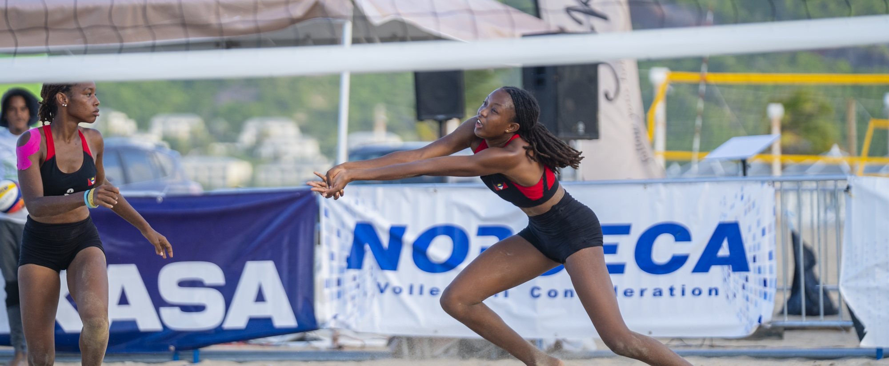
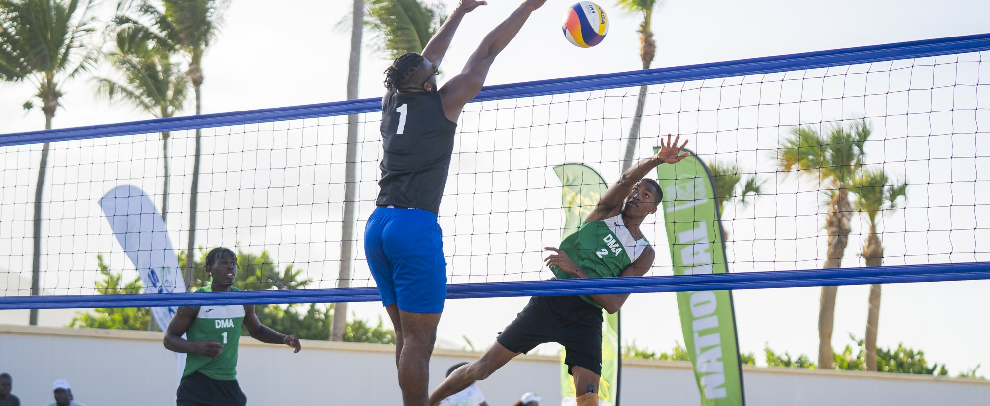
U21 Beach Championships 2025, St. Kitts and Nevis
2025 SEASON · JUNE
WOMEN Champions: Gaspard / Phillip (LCA)
MEN Champions: Mingo / Frederick (DMA)
Saint Lucia
Gaspard / Phillip
Dominica
Mingo / Frederick
Antigua and Barbuda
Joseph / Carr
Saint Lucia
Rio / Emmanuel
Dominica
Bully / Pascal
Grenada
Walcott / Hamilton
1
1
2
2
3
3
6–8 June 2025 · Supported by NORCECA (US$15,000) and Olympic Solidarity
Notes:
Source: 2025 President's Report. 6–8 June 2025, St. Kitts and Nevis. Supported by NORCECA (US$15,000, co-shared with IOC/FIVB support) and Olympic Solidarity. Photos: 10 Pictures & Media/2025/ECVA U21 Beach Championship/Selected Pics for FIVB.

Slide 8
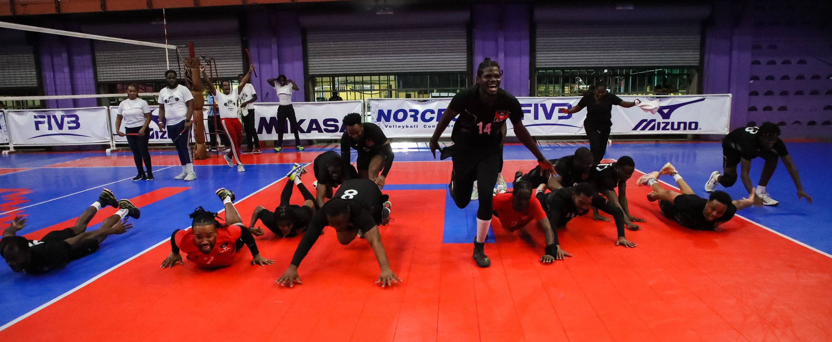

Men's and Women's Final 4, Antigua and Barbuda
2025 SEASON · SEPTEMBER
MEN 19–21 Sep · MVP Cairon Davis (ANT)
WOMEN 26–28 Sep
Antigua and Barbuda
Saint Lucia
Saint Lucia
Bermuda
Dominica
4th: Grenada
Antigua and Barbuda
4th: Grenada
1
1
2
2
3
3
First edition · Champions qualify to represent ECVA at the NORCECA Pan American Cup · NORCECA support US$85,000
Notes:
Source: 2025 President's Report. First edition of the ECVA Final 4. Men 19–21 September, women 26–28 September 2025, Antigua and Barbuda. Champions earn the opportunity to represent ECVA at the NORCECA Pan American Cup in 2026; Men's MVP Cairon Davis (norceca.info). NORCECA support US$85,000 for both events, including airline tickets and host support.

Slide 9
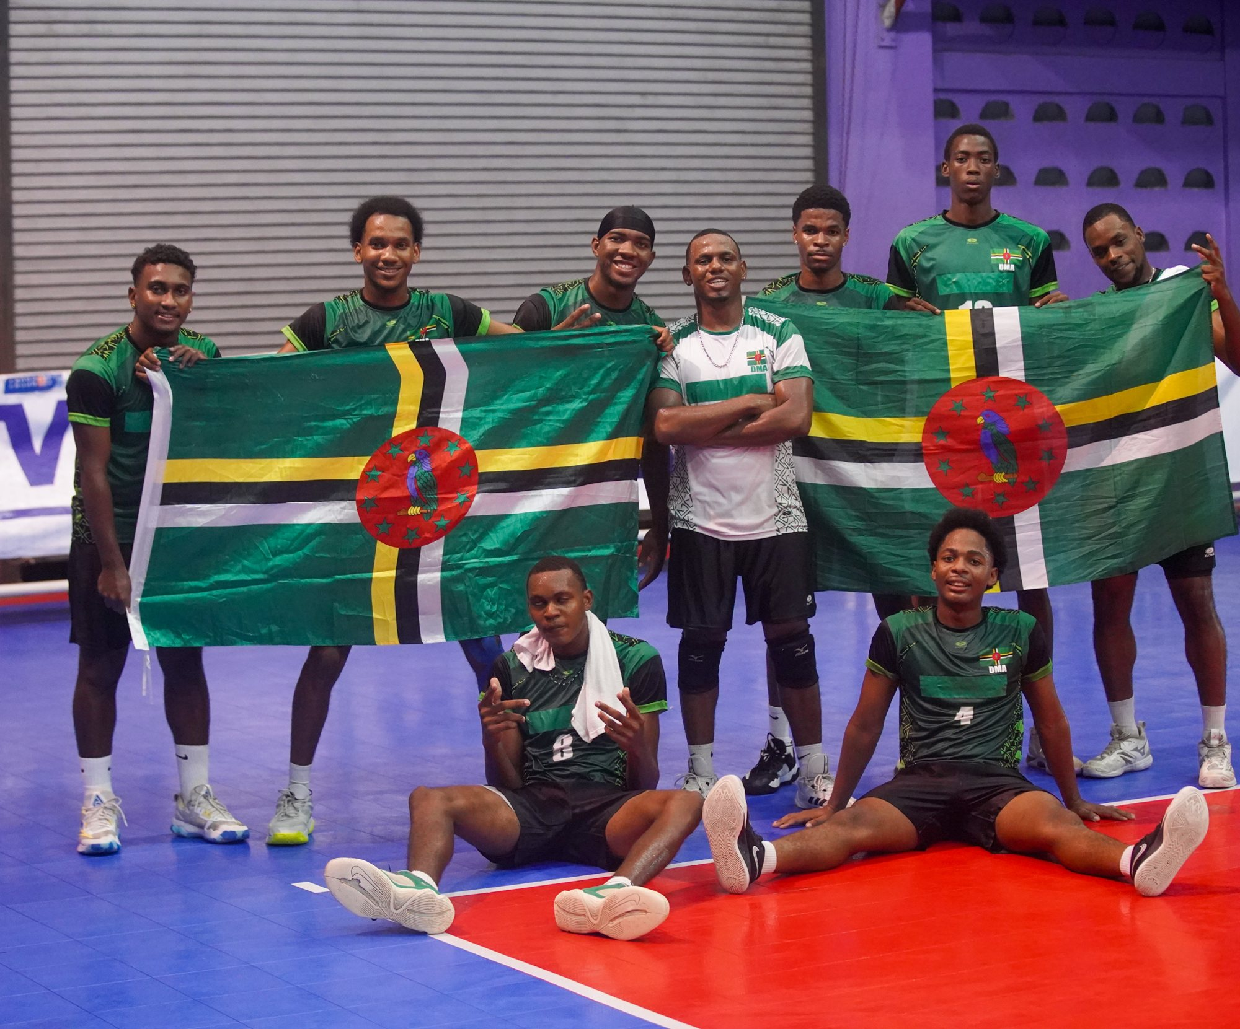
U23 Men's Championship, Antigua and Barbuda
2025 SEASON · NOVEMBER
12–16 November 2025
YMCA, St. John's, Antigua and Barbuda
Final Dominica defeated Antigua and Barbuda 3–1 · MVP Sherron Vidal (DMA)
Dominica
Antigua and Barbuda
Grenada
1
2
3
Notes:
Source: ECVA Report of Activities, 1 October 2025 to 30 September 2026 (FSRC revised). Gold: Dominica. Silver: Antigua and Barbuda. Bronze: Grenada. Final: Dominica defeated Antigua and Barbuda 3–1, 16 November 2025; Dominica unbeaten; MVP Sherron Vidal (norceca.info). Dates 12–16 November 2025 confirmed from match reports on norceca.info. Photo: Dominica after the gold medal match (10 Pictures & Media/2025/ECVA U-23/day 5/#18 Gold Medal ANT vs DMA/DSC08427.jpg).

Slide 10
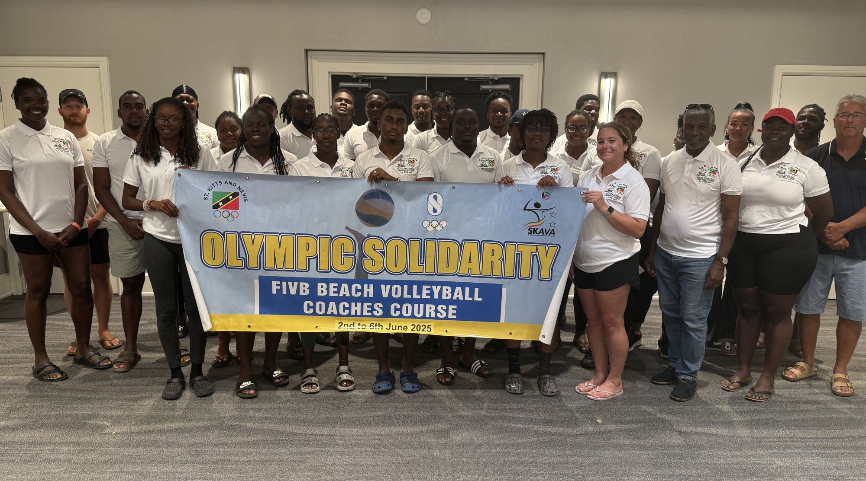





Building capacity in 2025
2025 SEASON · DEVELOPMENT AND GOVERNANCE
Beach Coaches Course · 1–6 June, St. Kitts
Instructor Rick Bevis (CAN). Funded by Olympic Solidarity via SKNOC and the FIVB Knowledge Transfer Programme.
Beach Referee Course · 4–8 June, St. Kitts
17 national referees from 10 NFs, 5 of them women. Instructors Brian Hiebert (CAN) and Kenneth Waugh (JAM).
Indoor referee seminar and virtual clinics
On-site seminar before the U23 championship; virtual MS Teams clinics before the senior events. Led by Brian Charles and Reginald Willemsberg.
FIVB Beach Volleyball Coaches Course, St. Kitts, June 2025
FIVB Empowerment Platform pilot zone
ECVA was chosen by the FIVB as the global pilot; federations were trained at the 11 September General Meeting.
100%
of matches at every 2025 event streamed live
One-on-one NF consultations · Oct–Nov
Over three years of archived footage was lost when YouTube blocked ECVA's channels.
Virtual sessions with every federation except Montserrat and French Saint Martin.
Notes:
Source: 2025 President's Report, sections 5, 7 and 9. ECVA was selected by the FIVB as the pilot zone for the global Empowerment Platform; training was given at the 11 September 2025 General Meeting. Consultations covered all NFs except Montserrat and French Saint Martin. Every match of every 2025 event was streamed live; ECVA's YouTube channels were blocked, losing over three years of archived footage, and appeals have been unsuccessful. Photo: 10 Pictures & Media/2025/Slideshow pictures/IMG_0366.jpg.

Slide 11

Development Workshop and AGM, St. Kitts
2025 SEASON · DECEMBER
Annual General Meeting
14 December 2025 · St. Kitts Marriott Resort
Reports received President's and Treasurer's reports, audited financial statements and technical reports.
Live streaming Identified as essential to visibility and fan engagement.
WORKSHOP · 11–13 DECEMBER
Commissions Federations agreed to set up marketing and other commissions by 15 January 2026.
FIVB Empowerment Platform and Knowledge Transfer
VIS and volleyball data management
Constitutions, voting, quorum and succession
Strategic planning, budgeting and financial transparency
Coach and athlete development, and communications (including Canva training)
Calendar 2025–2026 competition calendar confirmed; Knowledge Transfer and media strategy discussed.
Notes:
Source: ECVA Report of Activities, 1 October 2025 to 30 September 2026 (FSRC revised). Workshop 11–13 December 2025; AGM 14 December 2025, St. Kitts Marriott Resort. AGM outcomes on streaming, commissions and calendar: ECVA Press & Media Commission Report, Congress 2026. The Canva training was delivered by the Press Delegate.

Slide 12
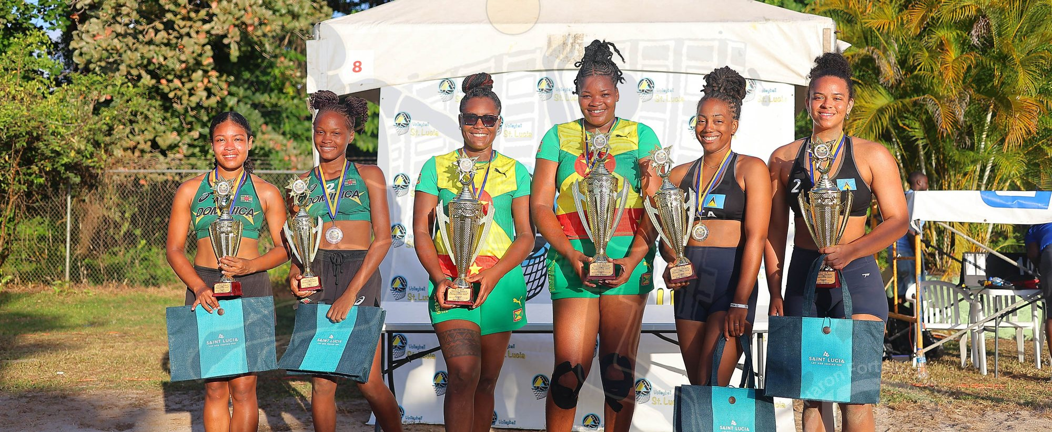

Senior Beach Championships 2026, Saint Lucia
CHAMPIONSHIPS · MAY 2026
WOMEN Final: Grenada won 2–1
MEN Final: 2–0 (21–17, 21–9)
Grenada
Mitchell / Stafford
St. Kitts and Nevis
Bristol / Morton
Saint Lucia
Phillip / Joseph
Sint Maarten
Jacob / Meulens
Dominica
Pascal / Burton
Dominica
Florent / Mingo
1
1
2
2
3
3
1–3 May · Cul de Sac sand courts · 25 teams (12 women's, 13 men's) from nine countries
Notes:
Source: ECVA Report of Activities, 1 October 2025 to 30 September 2026 (FSRC revised). 1–3 May 2026, Cul de Sac sand courts, Saint Lucia. 12 women's and 13 men's teams entered; nine countries represented.

Slide 13
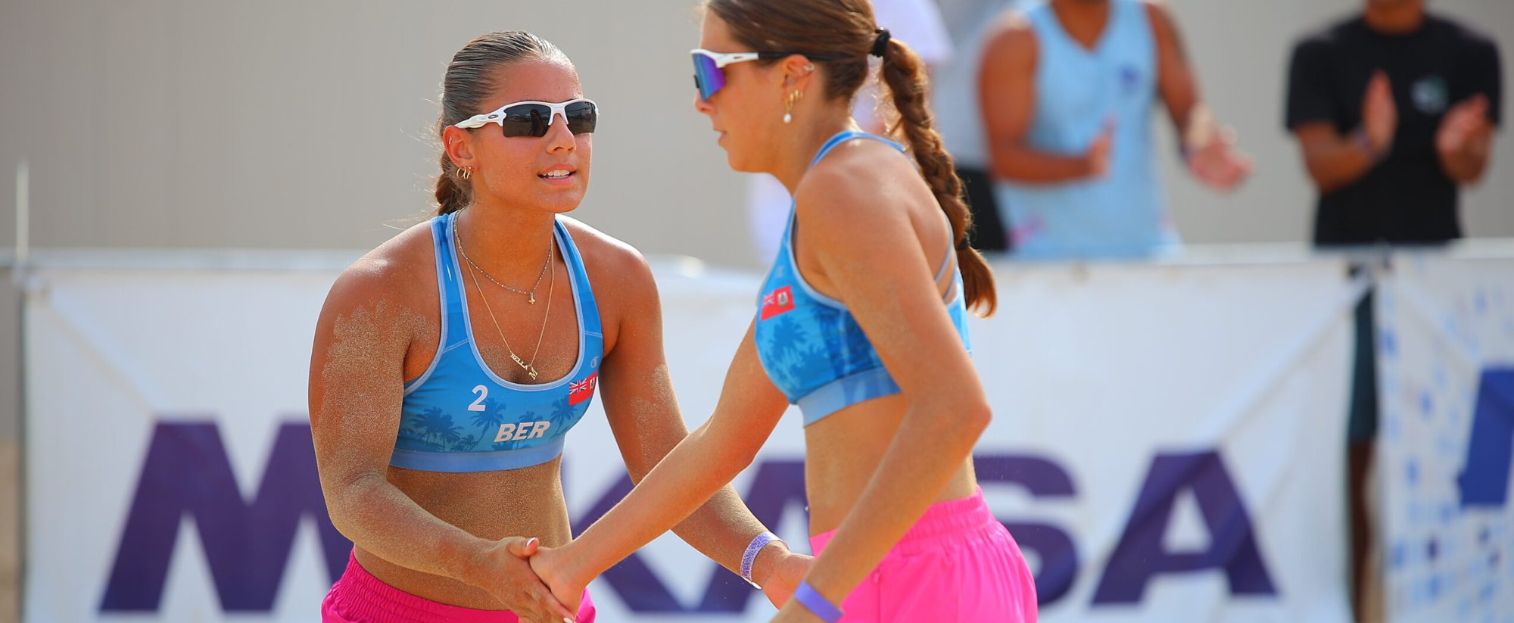
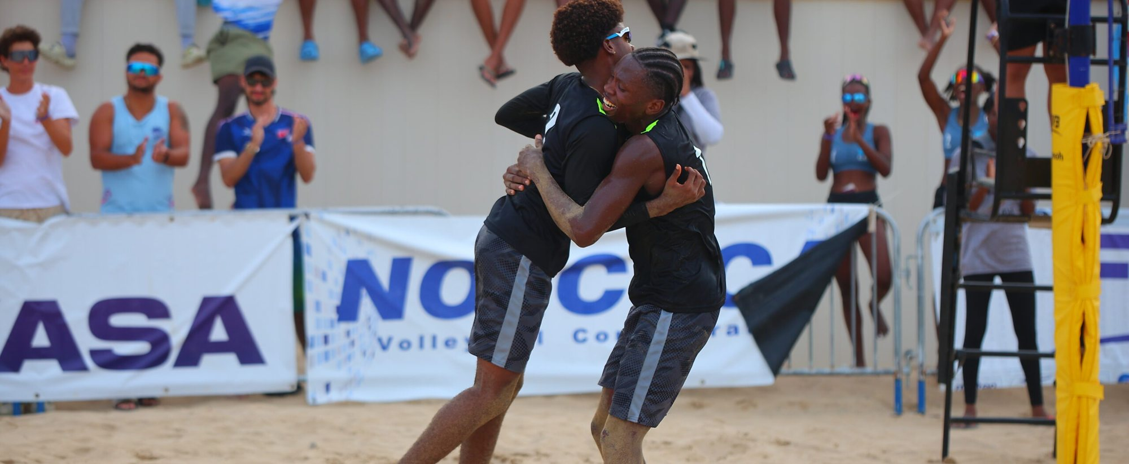
U20 Beach Championships 2026, St. Kitts and Nevis
CHAMPIONSHIPS · JULY 2026
WOMEN Final: Bermuda won 2–1
MEN Final: 2–0 (21–18, 21–19)
Bermuda
Gazzard / Sousa
Saint Lucia
Emmanuel / Clarke
St. Kitts and Nevis
Alwani / Pinney
Dominica
Tahj / Caiston
Saint Lucia
Abigail / Desir
St. Kitts and Nevis
Pencheon / Shiwamber
1
1
2
2
3
3
10–12 July · Frigate Bay, St. Kitts · Coach and referee courses ran alongside the championship
Notes:
Source: ECVA Report of Activities, 1 October 2025 to 30 September 2026 (FSRC revised). 10–12 July 2026, Marriott beach venue, Frigate Bay, St. Kitts. ECVA delivered coach and referee courses alongside the championship. Men's bronze: St. Kitts and Nevis, Pencheon / Shiwamber (confirmed by the President).

Slide 14
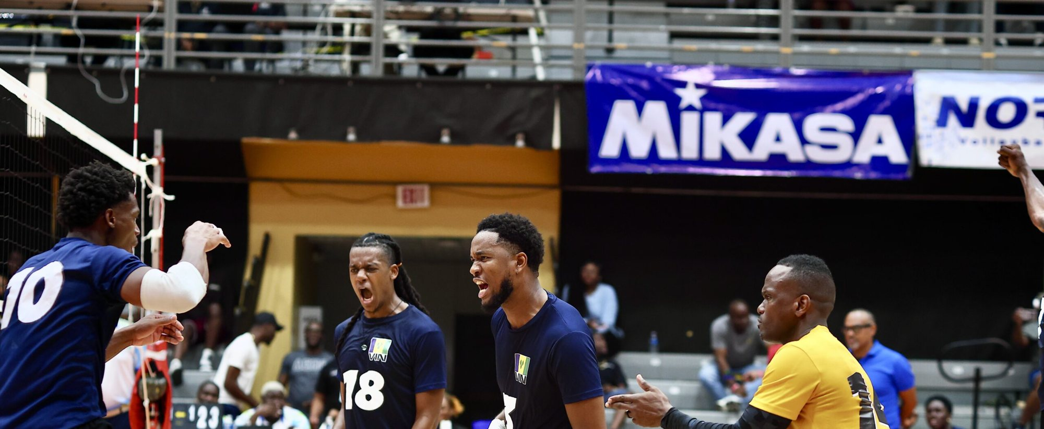
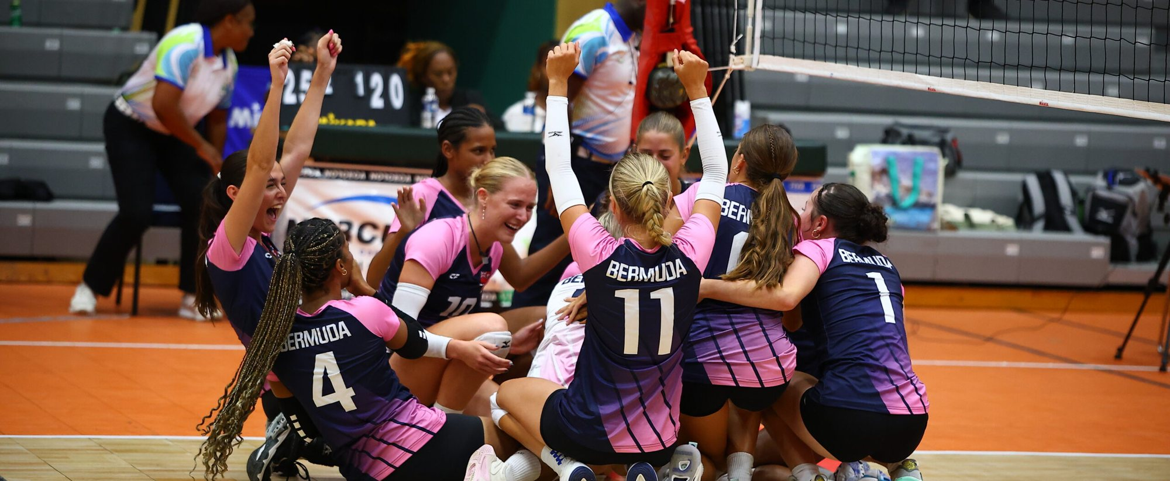
Senior Indoor Championships 2026, Tortola
CHAMPIONSHIPS · AUGUST 2026
MEN Final: St. Vincent and the Grenadines 3–1 Saint Lucia
WOMEN Final: Bermuda 3–1 Antigua and Barbuda
St. Vincent and the Grenadines
Bermuda
Saint Lucia
Antigua and Barbuda
Dominica
3–2 v Bermuda
Saint Lucia
3–0 v BVI
1
1
2
2
3
3
12–16 August · Tortola · 8 men's and 7 women's teams · Practical setting for the BVI referee course
Notes:
Source: ECVA Report of Activities, 1 October 2025 to 30 September 2026 (FSRC revised). 12–16 August 2026, Tortola. Eight men's teams (Anguilla, Antigua and Barbuda, Bermuda, BVI, Dominica, Grenada, Saint Lucia, St. Vincent and the Grenadines) and seven women's teams (Anguilla, Antigua and Barbuda, Bermuda, BVI, Dominica, Grenada, Saint Lucia). Medal-match scores: ecvolleyball.com tournament pages (men: VIN 3–1 LCA, DMA 3–2 BER; women: BER 3–1 ANT 25–23, 27–25, 21–25, 25–20; LCA 3–0 IVB).

Slide 15
Medals shared across eight federations
RESULTS · 2025–2026
39
medals across 13 men's and women's competitions in 2025 and 2026
7
different federations won gold. Saint Lucia won four
10
medals for Saint Lucia, the most of any federation. Dominica won 8
Notes:
Compiled from 13 podiums: 2025 Senior Beach (W, M), U21 Beach (W, M), Men's and Women's Final 4, U23 Men's; 2026 Senior Beach (W, M), U20 Beach (W, M), Senior Indoor (M, W). Totals (gold-silver-bronze): Saint Lucia 4-4-2; Bermuda 2-3-0; Dominica 2-1-5; St. Kitts and Nevis 2-1-2; Antigua and Barbuda 1-3-1; Grenada 1-0-3; St. Vincent and the Grenadines 1-0-0; Sint Maarten 0-1-0. Sources: 2025 President's Report, Report of Activities 2025–26, ecvolleyball.com.

Slide 16
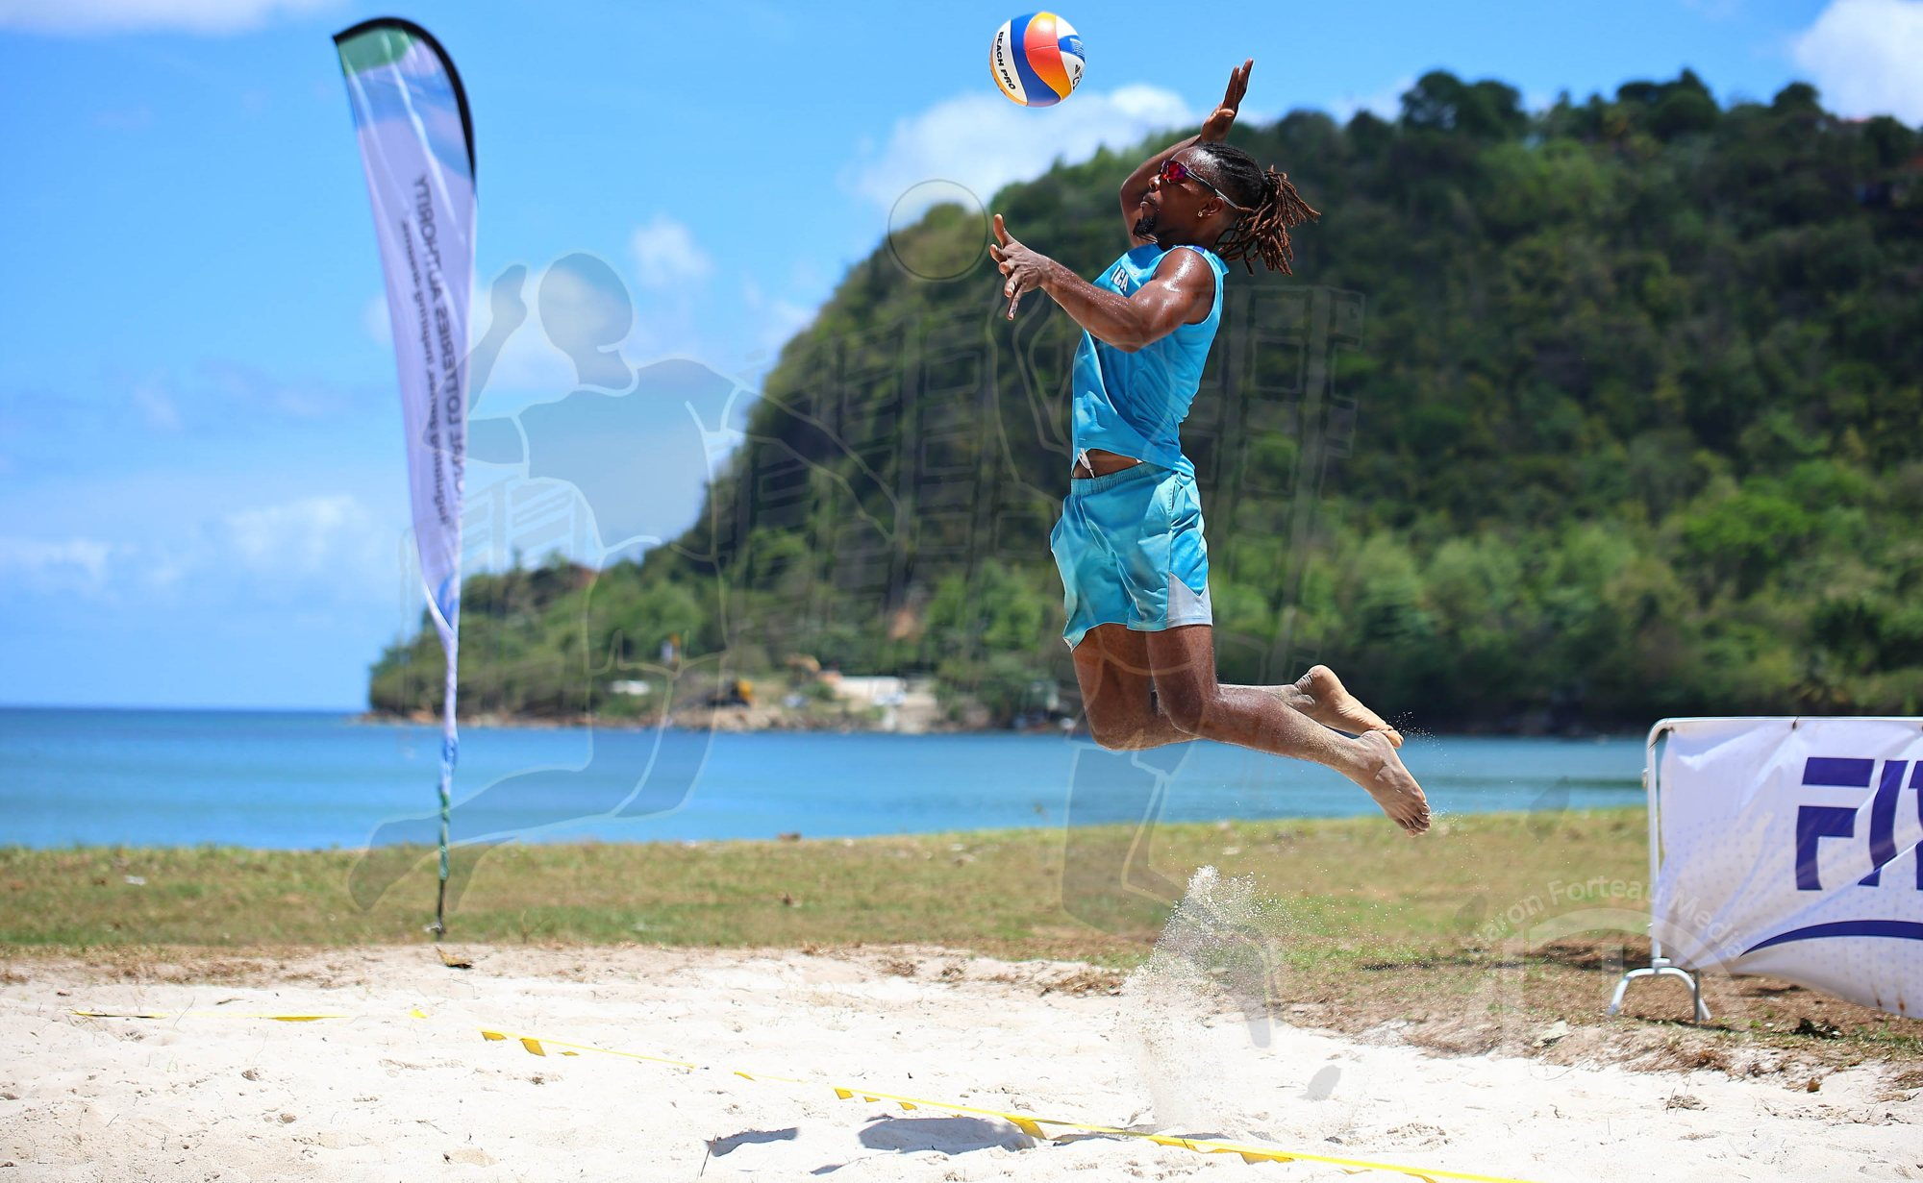
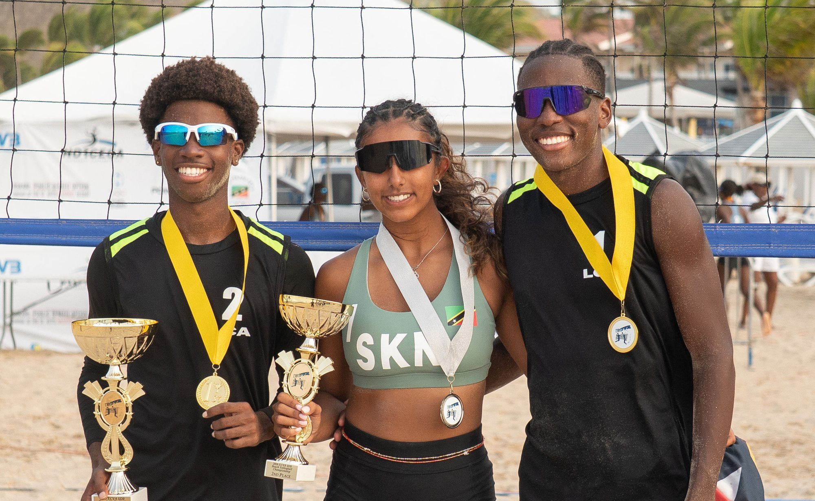
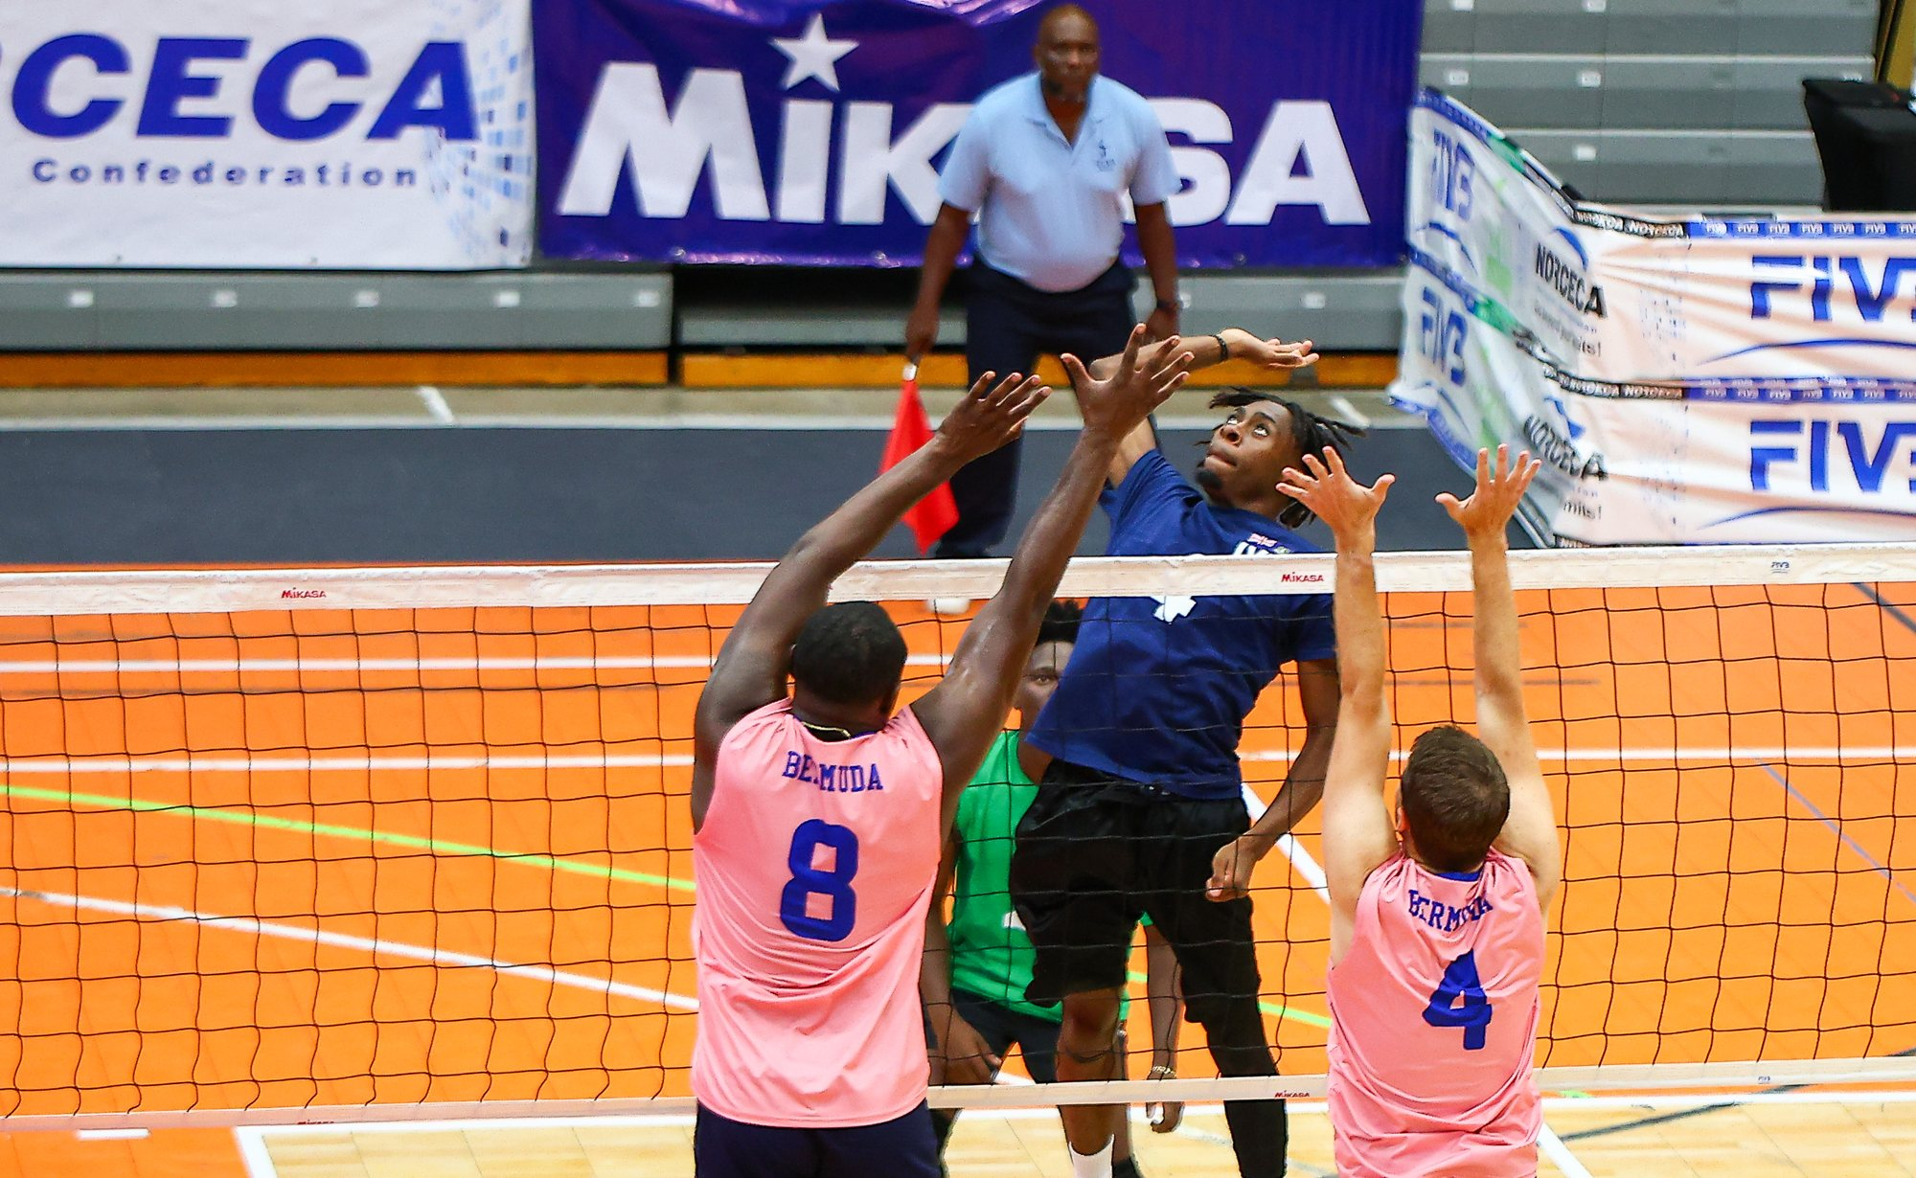
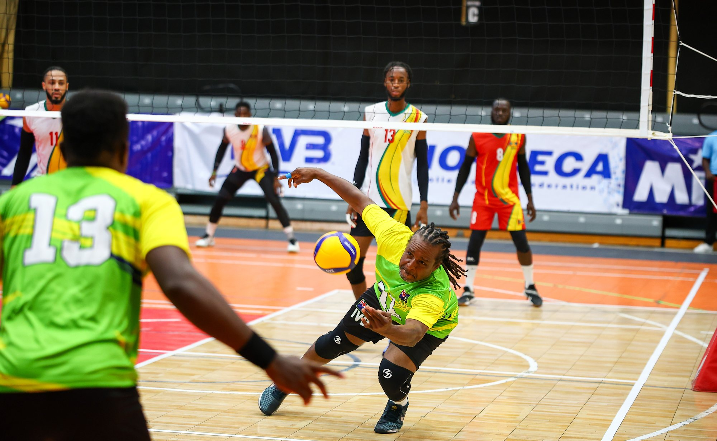
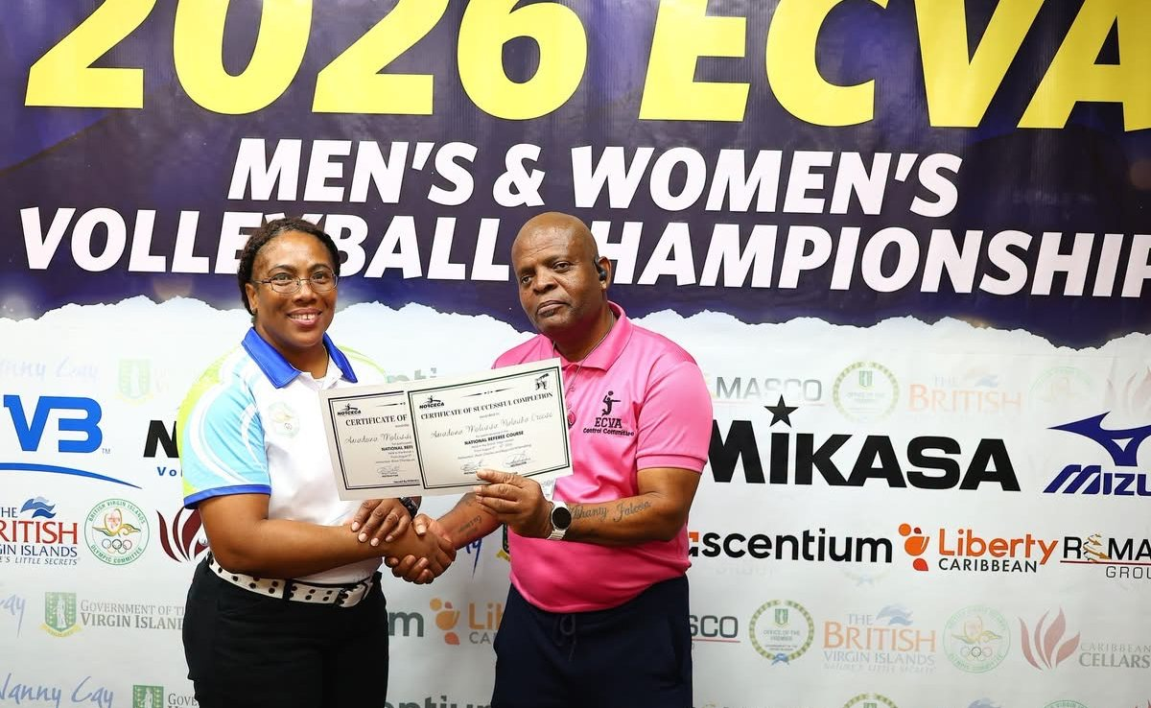
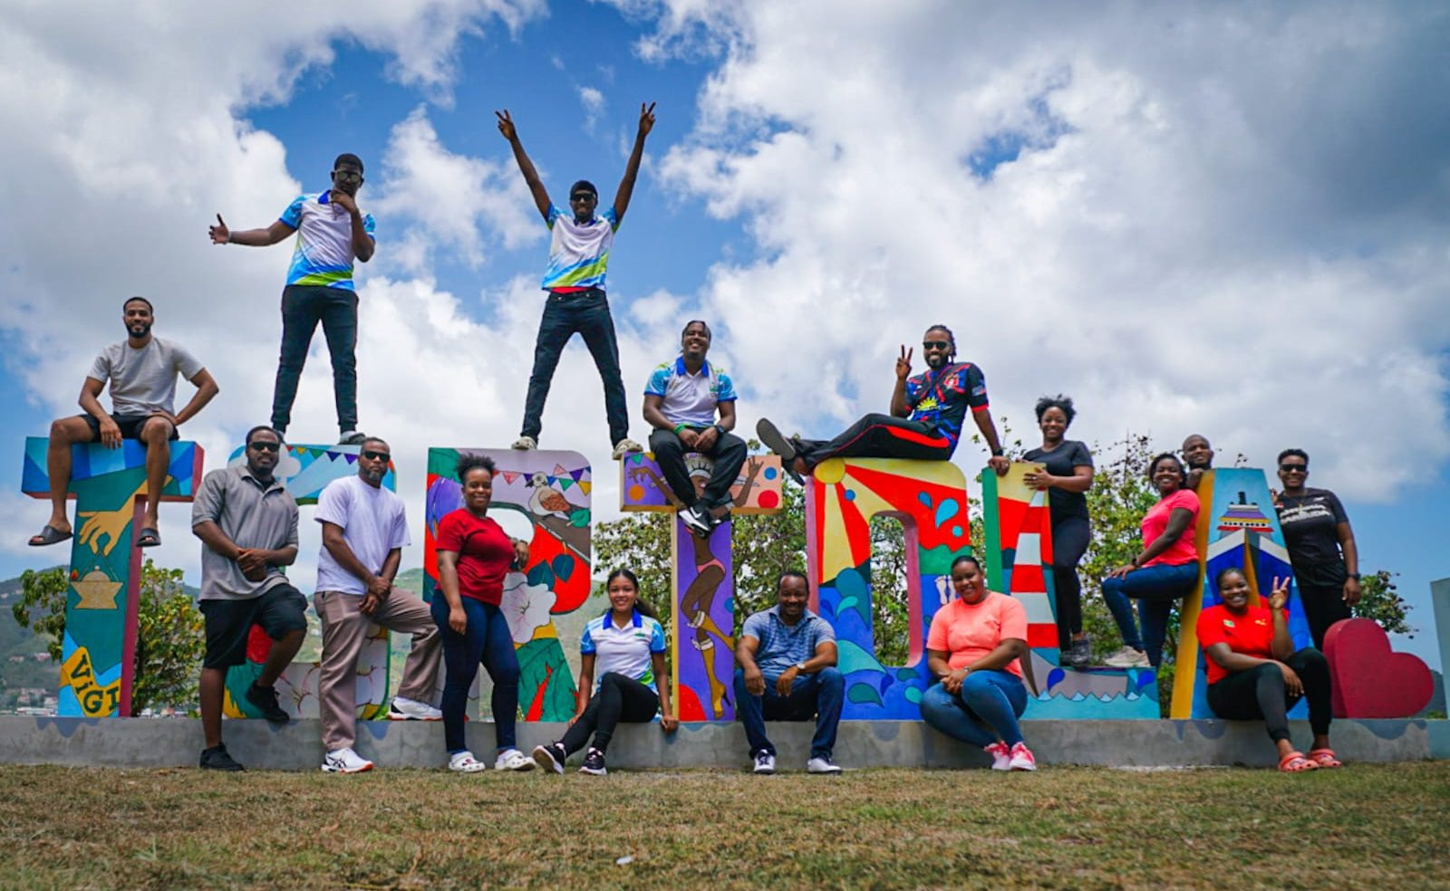
A season on sand and court
2026 IN PICTURES
Senior Beach, Saint Lucia
U20 Beach medal ceremony, St. Kitts
Senior Indoor, Tortola
Senior Indoor, Tortola
Referee certification, Tortola
Level 1 coaches, Tortola
Notes:
Photos from 10 Pictures & Media/2026: Senior Beach (KE4A2447), DJaaden - ECVA U20 (DSC09710), Senior Indoor - BVI (KE4A100702, KE4A899401), National Referee Course (IMG_0809), Level 1 Coaches Course (PHOTO-2026-08-22-13-27-14).

Slide 17

St. Kitts: competition combined with education
DEVELOPMENT · JULY 2026
July 2026
Mon 6
Tue 7
Wed 8
Thu 9
Fri 10
Sat 11
Sun 12
FIVB coaches course
Referee courses National: Julian Seraphine and Keam Charlery. International: Keith Murlless, with Andre Trottier online and Rogol Mills on site.
Advanced coaches seminar
Athlete training camp
Athlete365 Career+ workshop
International referee course
National referee course
U20 championship
Athletes and coaches not on the FIVB course arrived Monday 6 July. Paler bar: light sessions.
FIVB Beach Coaches Course
Advanced Beach Coaches Seminar
Athlete Training Camp
Athlete365 Career+ Workshop
6–10 July · Mark Kontopoulos, classroom and on-sand
Tue–Wed 7–8 July · Rick Bevis, with the training camp; certificates 10 July
Tue–Wed 7–8 July, light sessions Thu 9 July · Rick Bevis
Tue–Wed 7–8 July · Hazel-Ann Regis-Buckels (SKNOC)
Notes:
Source: ECVA Report of Activities, 1 October 2025 to 30 September 2026 (FSRC revised). July 2026 programme, St. Kitts and Nevis: coaches course 6–10 July; IRCC / international course 7–12 July; national referee course 8–9 July; U20 championship 10–12 July. FIVB Beach Volleyball Coaches Course instructor: Mark Kontopoulos. Rick Bevis led the Advanced Beach Coaches Seminar and the Athlete Training Camp, not the FIVB course (clarified by the President). Referee course instructors as listed in the Report of Activities. Participants who met course requirements received certificates. Athletes and coaches not on the FIVB course arrived Monday 6 July. Training Camp (Rick Bevis) Tuesday–Wednesday 7–8 July, light sessions Thursday 9 July. Advanced Beach Coaches Seminar 7–8 July in concert with the camp, certificates 10 July. Athlete365 Career+ Workshop (Hazel-Ann Regis-Buckels, SKNOC) 7–8 July.

Slide 18
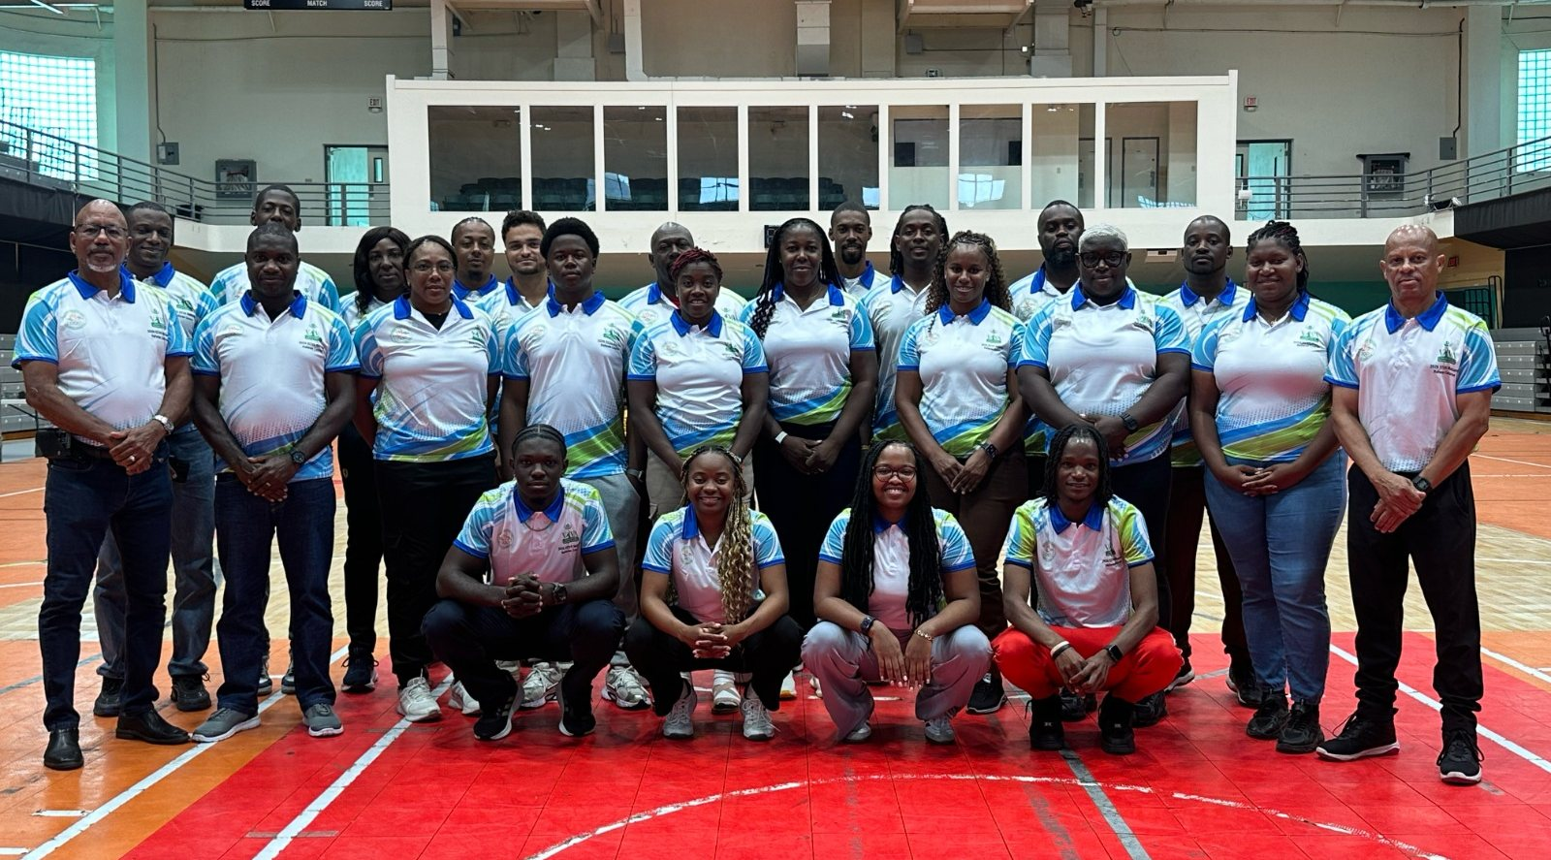
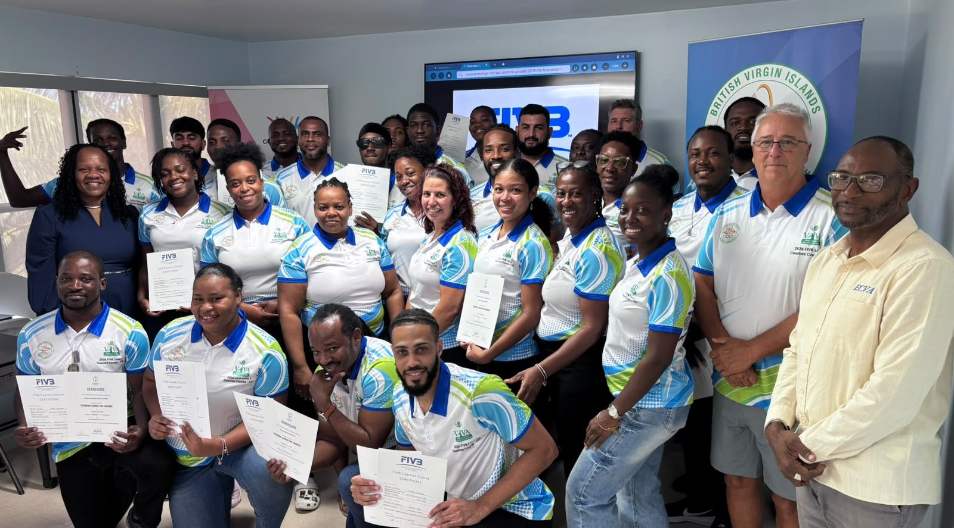
Tortola: referees and coaches certified
DEVELOPMENT · JULY–AUGUST 2026
ECVA National Referees Course
FIVB Level 1 Coaches Course
Officials from 12 territories
Coaches from 11 National Federations
21 Jul – 6 Aug Online sessions
17–21 Aug Instructor: Rick Bevis
10–11 Aug Classroom instruction
Outcome All participants certified at FIVB Level 1
12–16 Aug Practical training at the Senior Indoor Championships
Partners BVI NOC, BVI Volleyball Federation, Olympic Solidarity
Notes:
Source: ECVA Report of Activities, 1 October 2025 to 30 September 2026 (FSRC revised). BVI referee course: online sessions 21 July – 6 August, classroom 10–11 August, practical training 12–16 August; officials from 12 territories. FIVB Level 1 coaches course 17–21 August 2026, coaches from 11 National Federations, instructor Rick Bevis; all participants certified. Partners: BVI NOC, BVI Volleyball Federation and Olympic Solidarity.

Slide 19


Empowerment and member support
SERVING MEMBERS
FIVB Empowerment and Knowledge Transfer
Competition and education
Funding and administration
ECVA administered implementation and reporting for participating National Federations
Empowerment Platform demonstrated at the December workshop
Knowledge Transfer and VIS data management explored with federations
Coordinated entries in ECVA events
Facilitated coach and referee courses
Helped athletes and teams reach continental competition
Helped with development-funding applications and reporting
Coordinated with FIVB, NORCECA and NOCs
Provided technical and administrative guidance
Notes:
Source: ECVA Report of Activities, 1 October 2025 to 30 September 2026 (FSRC revised). Slides 21–22: FIVB Empowerment and Knowledge Transfer; support to member organisations.

Slide 20


Each commission reports in full separately
COMMISSION HIGHLIGHTS
Technical Operations
Press and Media
Referees
147
hours streamed live
3.1M
Facebook views
17
national beach referees trained in 2025 (10 NFs)
6
championships run on VIS and eScore
~80
ECVA articles on the NORCECA portal
41
registered ECVA referees officiated, 2023–25
Beach eScore and portable streaming were proven at both beach events. Continuity still depends on bandwidth, spares and staffing.
Instagram grew to 1,167 followers. ECVA's YouTube channel was lost to a copyright ban, along with its video archive.
Virtual clinics on MS Teams introduced in 2025. Some NFs still not fully compliant with FIVB referee registration.
See the Technical, Press and Media, and Referees reports for full detail.
Notes:
Summary only; each commission presents its own report. Technical: ECVA 2026 Technical Report (Shane Roachford, 10 October 2026): 147 Twitch stream hours across three deployments; six championships supported by VIS and VolleyStation Score/Ref. Press: ECVA Press & Media Commission Report, Congress 2026 (Judy Larocque): 3.1M Facebook views May 2025 – October 2026, ~80 articles on the NORCECA portal, 1,167 Instagram followers, YouTube channel removed over copyright. Referees: ECVA 2025 Referee Commission Report (Chair Reginald Willemsberg, SXM, member of the NORCECA Referee Commission): ECVA National Beach Volleyball Referee Course, Frigate Bay, 4–8 June 2025, instructors Brian Hiebert and Kenneth Waugh, 17 national referees (5 women, 12 men) from 10 NFs plus 5 experienced beach referees; virtual referee clinics via MS Teams introduced in 2025, led by R. Willemsberg and B. Charles; 41 ECVA referees (plus Brian Charles, TTO) registered with the FIVB and officiated at ECVA tournaments 2023–2025, from 10 federations, 11 of them women. Indoor international referees: Duane Daniel (VIN), Servani Eckersly (SXM), Shirlon Jeria-Hunte (LCA); continental candidates Rawle Lee (ANT), Monique Martis (EUX). Beach: FIVB international referees Keam Charlery and Elvin Germain (LCA), Julian Seraphine (DMA); continental Kemroy Percival and Rogol Mills-Costoso (SKN), Henry Matthew (ANT); continental candidate Micheal Hamilton (ANT). Eight member federations have no international referee. 2026 courses per the Report of Activities (St. Kitts national and international beach courses, July; BVI national course, officials from 12 territories).

Slide 21
FIVB and Olympic Solidarity: US$280,000
FUNDING AND ACCOUNTABILITY
US$240,000
US$40,000
Olympic Solidarity
FIVB Empowerment Programme
via the ten affiliated National Federations
10
×
4
×
US$6,000
NORCECA
affiliated NFs
courses each
per course
US$618,450.41 in 2025 (audited)
Every ECVA championship
Every ECVA course
Every team on the NORCECA beach tour
The ECVA website
Equipment for the technical team and VIS
Beach volleyball coaches course
Level 1 coaches course
Beach volleyball referee course
National referee course
Each NF signed its course funds over to ECVA to deliver the programme regionally.
Notes:
Funding as advised by the President: US$240,000 from the FIVB through the Empowerment Programme, via the ten affiliated National Federations. Each NF received US$6,000 per course for four courses (beach volleyball coaches course, Level 1 coaches course, beach volleyball referee course, national referee course) and signed the funds over to ECVA: 10 × 4 × US$6,000 = US$240,000. Olympic Solidarity provided US$40,000. NORCECA supported each championship, each course and every team participating in the NORCECA beach tour, supports the ECVA website, and funded the equipment for the technical team and VIS. ECVA administered the funding, kept invoices and supporting documents, and coordinated reporting to FIVB, NORCECA and Olympic Solidarity (Report of Activities, slides 24–25).

Slide 22



ECVA on the continental stage
REPRESENTATION
Continental competition
Beach selections
ECVA gave financial and administrative support for NORCECA events, including the men's U23 Pan American Cup in El Salvador (September 2026).
Bermuda: Olivia Gazzard and Sophie Weikl for the NORCECA U18 qualifier. St. Kitts and Nevis: Bristol / Morton and Hensley-Phillip / Gumbs for the Costa Rica tour opener.
NORCECA commissions, 2024–2028
Institutional status
Albert Ogarro joined the Technical, Statistics and VIS Commission; Judy Larocque joined the Press Commission.
Work continued on Regional Member status within NORCECA and potential future FIVB affiliation.
FIVB World Ranking, October 2026: Bermuda women 49th; Dominica men 59th, the highest-ranked ECVA men's team.
Notes:
Source: ECVA Report of Activities, 1 October 2025 to 30 September 2026 (FSRC revised). Slides 23, 26–27. FIVB World Ranking positions: ECVA Facebook posts of 9 October 2026 cited in the Press & Media Commission Report (after the reporting period).

Slide 23


What went well, and where we fell short
2025–2026 IN REVIEW
Successes
Challenges
Two full seasons: 8 championship events and 13 competitions in four host federations
YouTube channels blocked: over three years of match video lost; appeals unsuccessful
9 coach and referee courses and seminars, most run alongside competition
Live streaming not yet standard; connectivity and spare equipment limit continuity
Medals shared across eight federations, with seven different gold medallists
Media and technical resources vary from host to host
Every 2025 match streamed live; all 2026 championships streamed and run on VIS
Audience and match data still compiled and re-entered by hand
Chosen by the FIVB as the global pilot zone for the Empowerment Platform
Uneven federation capacity, including incomplete FIVB referee registration
Partner investment: NORCECA US$618,450 (2025, audited); FIVB US$240,000; Olympic Solidarity US$40,000
Youth athletes age out quickly; underage championship funding needs revival
Notes:
Successes drawn from the Report of Activities and championship results. Challenges drawn from the Press & Media Commission Report (host media resources, streaming, federation capacity, YouTube ban, manual data compilation) and the 2026 Technical Report (bandwidth, staffing and spares; manual re-entry between systems). Also worth noting: some ecvolleyball.com tournament listings need correcting, e.g. the 2025 U23 Men's Championship is listed as 12 Nov – 16 Oct 2025.

Slide 24



Priorities for the coming year
LOOKING AHEAD · 2026–2027
Institutional standing
Youth pathway to 2029
Stream every championship
Advance Regional Member status in NORCECA and explore future FIVB affiliation.
U19 championships and annual U23 NORCECA participation, aiming at the 2029 Junior Pan American Games.
Use NORCECA's streaming support for zonal associations, starting with finals days.
Beach performance plan
Restore our video channel
Stronger federations
Fund top ECVA teams on the NORCECA Beach Tour, with an ECVA coach and a pre-tour camp.
Appeal the YouTube ban, or relaunch under ECVA control with a clear copyright policy.
A media focal point in each federation, full FIVB referee registration, and more referee clinics and mentoring.
Notes:
Youth pathway and beach performance plan: 2025 President's Report, sections 9.3–9.4. Other priorities draw on the Report of Activities (regional membership, Sint Maarten AGM), the Press & Media Commission recommendations for 2027 (streaming, host agreements, video channel, federation focal points) and the Technical Report priorities (host infrastructure, regional operators).

Slide 25

Rick Bevis
WITH OUR BEST WISHES
Rick was seriously injured while on assignment in Bermuda in September 2026 and faces a long and challenging recovery. The ECVA family wishes him strength, comfort and a full recovery.
HIS WORK IN THE ECVA ZONE
FIVB coach, Bermuda
Several seasons as the FIVB coach in Bermuda
FIVB Beach Volleyball Coaches Courses, St. Kitts
Coaching instructor in 2023, 2024 and 2025, under ECVA's Knowledge Transfer projects
Advanced Beach Coaches Seminar and Athlete Training Camp
Instructor · St. Kitts, July 2026
FIVB Level 1 Coaches Course
Instructor; every participant certified · Tortola, August 2026
Rick Bevis, Tortola, August 2026
Notes:
Rick Bevis (CAN) was very badly injured while on assignment in Bermuda in September 2026 and has a long and challenging recovery ahead. ECVA wishes him well. As advised by the President: FIVB coach in Bermuda for several seasons; coaching instructor for the FIVB Beach Volleyball Coaches Courses in St. Kitts in 2023 and 2024 under ECVA's Knowledge Transfer projects, and in June 2025 (2025 President's Report); instructor for the Advanced Beach Coaches Seminar and the Athlete Training Camp, St. Kitts, July 2026 (he did not teach the 2026 FIVB coaches course); instructor, FIVB Level 1 Coaches Course, Tortola, 17–21 August 2026. Photo supplied by the President.

Slide 26

IN MEMORIAM
Darrion Roberts
1994 – 2026
National Libero
ECVA Scorer
Student of the Game
Notes:
Tribute to Darrion Roberts (1994–2026), National Libero, ECVA Scorer, Student of the Game. Photo from the ECVA 2026 Technical Report.

Slide 27
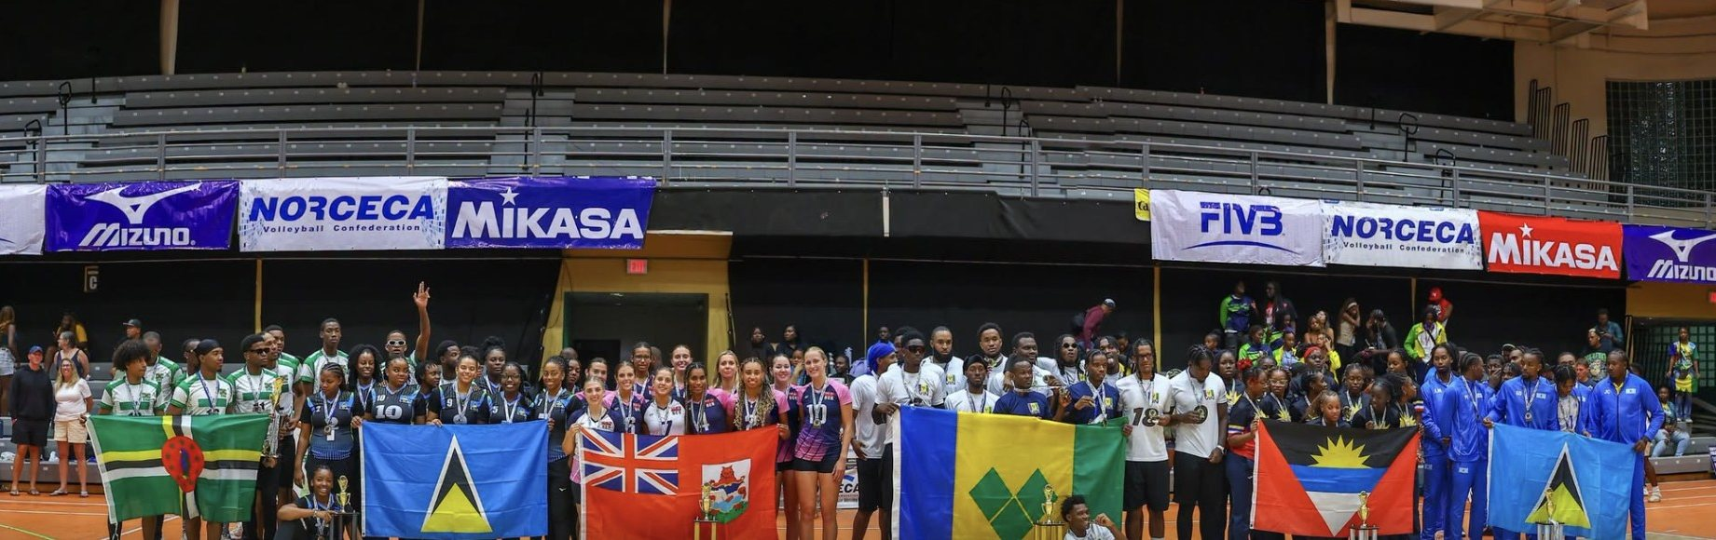
Thank you
With thanks to
Vice President Sabinah Clement, Treasurer Wilbur Harrigan OBE, Secretary General Shayne Felicien and Elvin Henríquez; NORCECA and President Cristóbal Marte Hoffiz, the FIVB, Olympic Solidarity, SKNOC and SLOC; our host federations; the instructors, officials, volunteers and commissions who delivered the year.
Glenn Quinlan
President, ECVA
ecvolleyball.com
Notes:
Board members as listed at ecvolleyball.com/about: Glenn Quinlan (President), Sabinah Clement (Vice President), Wilbur Harrigan OBE (Treasurer), Shayne Felicien (Secretary General), Elvin Henríquez (Member). Photo: medallists of the 2026 ECVA Senior Championships, Tortola.

