Slide 1
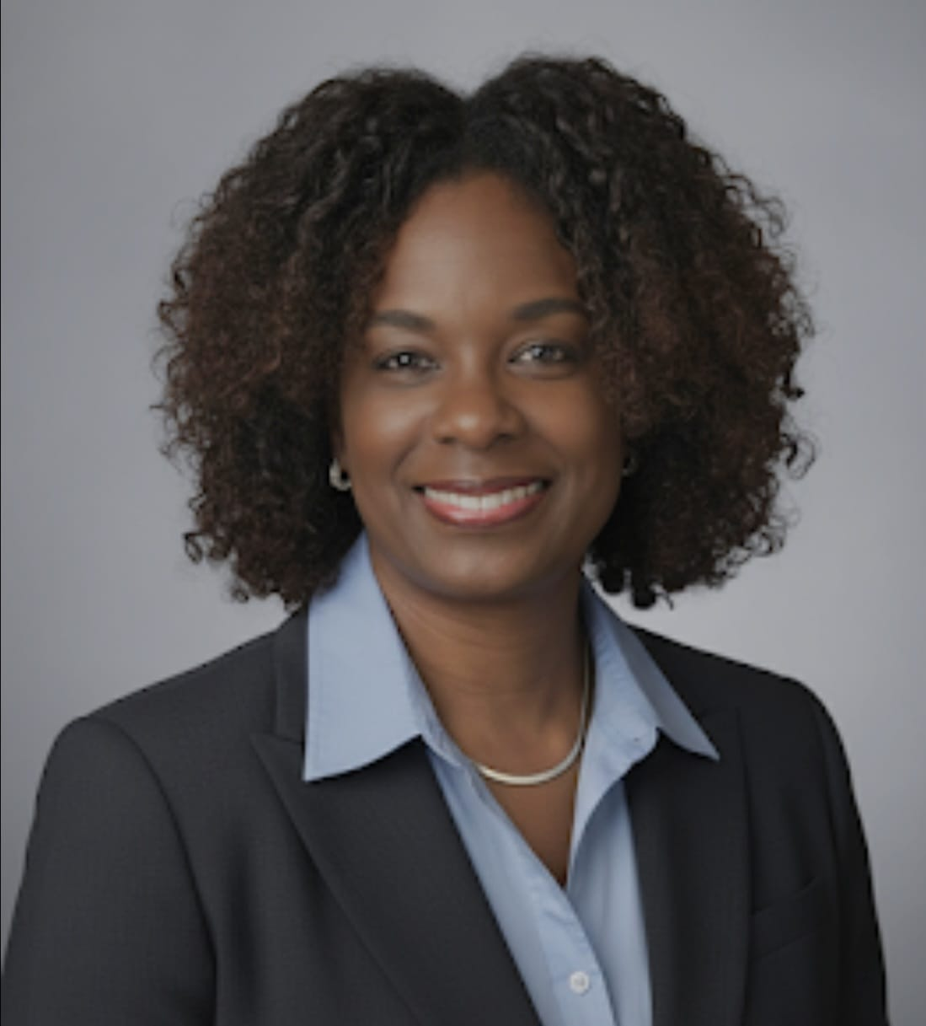
Strengthening National Sporting Federations
Importance of Constitutions & Regulations –
Core Elements,
Best Practices, and
Pitfalls.
Sabinah Clement
Notes:
Explain that governance documents are essential for credibility and stability in sport.

Slide 2
Why Constitutions & Regulations Matter for National Federations
- Establish a clear governance structure
- Provide legal and operational clarity
- Define the federation’s mandate within the national sports ecosystem
- Provide legal legitimacy and alignment with national laws and NOC requirements
- Ensure transparent, fair, and democratic governance
- Protect the rights of athletes, members, and stakeholders
- Reinforce accountability to government, sponsors, and international bodies
Notes:
Highlight why NFs must have strong constitutions/by-laws.

Slide 3
Reputational Risk Mitigation
- Clear governance reduces risk of scandals and governance failures
- Transparent processes build trust with athletes, public, and media
- Proper disciplinary mechanisms protect federation integrity
- Helps maintain sponsorships and funding by demonstrating strong governance
- Ensures credibility when dealing with international federations
Notes:
Explain how poor governance can damage reputation; emphasise trust with public, sponsors, and IFs.

Slide 4
Key Components of a Federation’s Constitution
Name,
Legal status, and national recognition
Purpose, mission, and role in national sports development
Board/Executive Committee composition and authority
Membership requirements and categories
(clubs, athletes, officials)
Voting rights
Structure of General Assembly
Detailed election procedures
(nominations, conduct of elections, voting, disputes)
Notes:
Walk through the foundational elements and why each is critical for transparency. Emphasis on – AGM and cvoting rights, election procedures, board composition and amendment process.

Slide 5
Key Components of a Federation’s Constitution (Cont’d)
Term limits,
Election cycles,
Eligibility criteria
- Meeting protocols (AGMs, EGMs)
Financial governance, audits, and reporting
Authority to create commissions/sub-committees
- Authority to create Regulations/By-Laws
Amendment procedures (how, who, when)
Deferring to Constitution of governing bodies in areas where NF’s constitution is silent.
Notes:
Walk through the foundational elements and why each is critical for transparency. Emphasis on – AGM and cvoting rights, election procedures, board composition and amendment process.

Slide 6
Regulations:
Operational and Governance Details
- Code of ethics and conduct for athletes, officials, and administrators
- Conflict-of-interest procedures
- Disciplinary frameworks and appeals mechanisms
- Technical and competition rules (overview)
- Data protection, safeguarding, and anti-harassment provisions
Delegation of authority and committee roles
Anti-money laundering, counter-terrorist financing policies and procedures
- Amendment procedures (how, who, when)
Notes:
Explain that by-laws operationalise the constitution and provide daily governance clarity.

Slide 7
Benefits of Strong Constitutions & Regulations
- Protects organizational integrity
- Enhances credibility with government, sponsors, and the community
- Mitigates reputational, legal, and operational risks
- Ensures consistency and fairness in decision-making
- Improves athlete and member trust
- Strengthens compliance with international federation standards
- Supports long-term strategic planning and stability
Notes:
Focus on risk mitigation, credibility, and long-term federation health.

Slide 8
Best Practices
- Benchmark against leading international federations
- Conduct regular reviews (every 2–4 years)
- Consult athletes, clubs, coaches, and other stakeholders
- Use clear, plain language to avoid interpretation issues
- Ensure compliance with national sports legislation and NOC guidelines
- Maintain independent judicial/ethics bodies
- Provide governance training for Board members
Notes:
Emphasise alignment with IF standards and national laws; stress need for periodic review.

Slide 9
Common Pitfalls to Avoid
- Ambiguous or contradictory clauses
- Outdated documents not aligned with current laws or IF statutes
- Overly centralised power with no checks and balances
- Poor election transparency or integrity issues
- Regulations that are too rigid or difficult to amend
- Lack of education for members about their rights and obligations
- Failure to publish governance documents publicly
Notes:
Give real examples of pitfalls (anonymous) and consequences.

Slide 10
Case Studies
Case Study #1
Thorough considerations in elections –
Establishment of an Electoral Code to specifically and thoroughly deal with the entire electoral process from nominations through to declaration of winners.
Case Study #2
Pitfall -Cumbersome membership requirements

Slide 11
Positions to be Elected
President
2 Vice Presidents
Treasurer
3 Directors
At least 1 of these must be of the gender in minority
Requirements of Candidates
All Candidates for the Executive Committee must:
Be no older than 70
Presidents and Vice Presidents must be nationals of country X
Any other member must be a resident in the country for at least 5 years
Not found guilty of any criminal offence
Not be a delegate to the AGM or a member of any other body of the NF
Not represent a Member who is already represented on the Executive Committee by another Director.

Slide 12
Nominations
Each candidate must be proposed by at least 2 members and must pass an integrity check
Candidatures must be sent to the secretariat 35 calendar days before the AGM
Official list of candidates must be passed to members 14 days before the AGM
Electoral supervisor
Elections shall be conducted in accordance with the electoral code of NF-X and shall be supervised by the Electoral Supervisor.
Appeals against decisions of the Electoral Supervisor shall be heard by the Appeals Committee.

Slide 13
Election Process (Article 30 of Constitution & Article 14 of Electoral Code)
For the election of president and vice president, a majority of >50% is required.
If there are more than two candidates for president or vps, the candidate gaining the lowest number of votes will be eliminated until only two candidates are left.
For the other members of the executive committee, the candidates receiving the most votes in respect of the free seat(s) shall be elected.
In the event of a tied vote for any position, two new ballots will be conducted. If after those two new ballots the tie remains, the position shall remain vacant until a new elective general meeting is convened to hold new elections.

Slide 14
Election Process (Article 30 of Constitution & Article 14 of Electoral Code)
Voting is by SECRET BALLOT.
Voting delegates will be verified against delegates list by producing id.
The electoral supervisor will call each voting delegate to move to the front of the general meeting hall.
Once called, the delegate will sign receipt of the ballot sheet.
Votes will be cast privately by each voting delegate at the designated voting area.
No mobile phones will be permitted in the voting area.
Once votes are cast, the ballot sheet will be folded twice and placed in the ballot box. The delegate will sign the electoral register and return to their seat.
Counting of votes will commence as soon as all of the delegates have deposited their ballot sheets in the ballot box.
The electoral supervisor will remove and count the votes in front of all the delegates.

Slide 15
Election Process (Article 30 of Constitution & Article 14 of Electoral Code)
The electoral supervisor shall take any decisions regarding the validity or invalidity of ballot papers.
Votes will be counted with real time tracking on screen in front of all members.
If second or successive voting rounds are required, the counting of votes for the remaining candidates will recommence from 0.
At the end of the voting process, the electoral supervisor will declare the official results.

Slide 16



Case Study #2
Eligibility - Who is a Member?

Slide 17

Membership is open to any:
Team,
Association, or
Club
Which is organized to play sport Z.

Slide 18
Membership is by application to the Executive Committee (“ExCo”)
Application must be sent/given to the Secretary for submission to Exco for consideration and must include:
A “properly completed roster”* signed on behalf of the team, association or club;
Annual Membership Dues, (pursuant to Article 19)

Slide 19
Properly completed Roster
A roster must contain:
The names and details of 12 active players
  Details must include address, height, weight, DOB, position and proof of identification.
The name of a Manager
The name of a Coach
The name of a Captain
A Practice Schedule
  Schedule must include details of days, times and venues and must be signed by the named Manager and Coach.
Notes:
No admission for any member other than teams, clubs or associations.
Possibility that associations have teams or clubs so two bites at membership.
Documentation requirements are onerous

Slide 20
ExCo to consider admission of members
Upon submission of the rosters by the Secretary (within a reasonable time following receipt), ExCo will consider and vote on whether to approve or reject the membership application of any team, association or club.
Voting will require a simple majority of ExCo.

Slide 21
Implementing Effective Constitutions and Governance
Make constitution & Regulations accessible via website and handbooks
Communicate governance documents clearly to all members
- Integrate governance expectations into membership agreements
- Ensure uniform enforcement of disciplinary, ethics, and election procedures
- Document and publish key decisions for transparency
Track compliance and conduct periodic governance audits
Follow the letter of the Constitution!
Notes:
Reinforce importance of communicating rules and consistent enforcement.

Slide 22
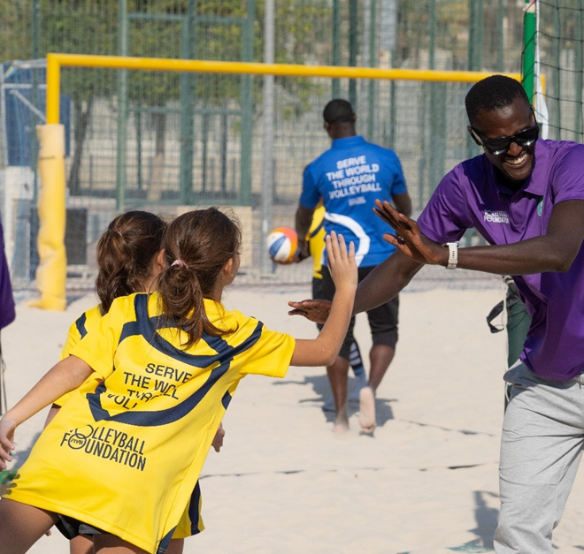
Conclusion
Robust constitutions and Regulations strengthen national federations by:
Providing clear rules for the conduct of the NF,
protecting their reputation,
ensuring transparency;
Maintaining fairness, and
Ensuring sustainable governance.
Notes:
Close with reminder that strong governance protects the sport and its athletes.

Slide 23
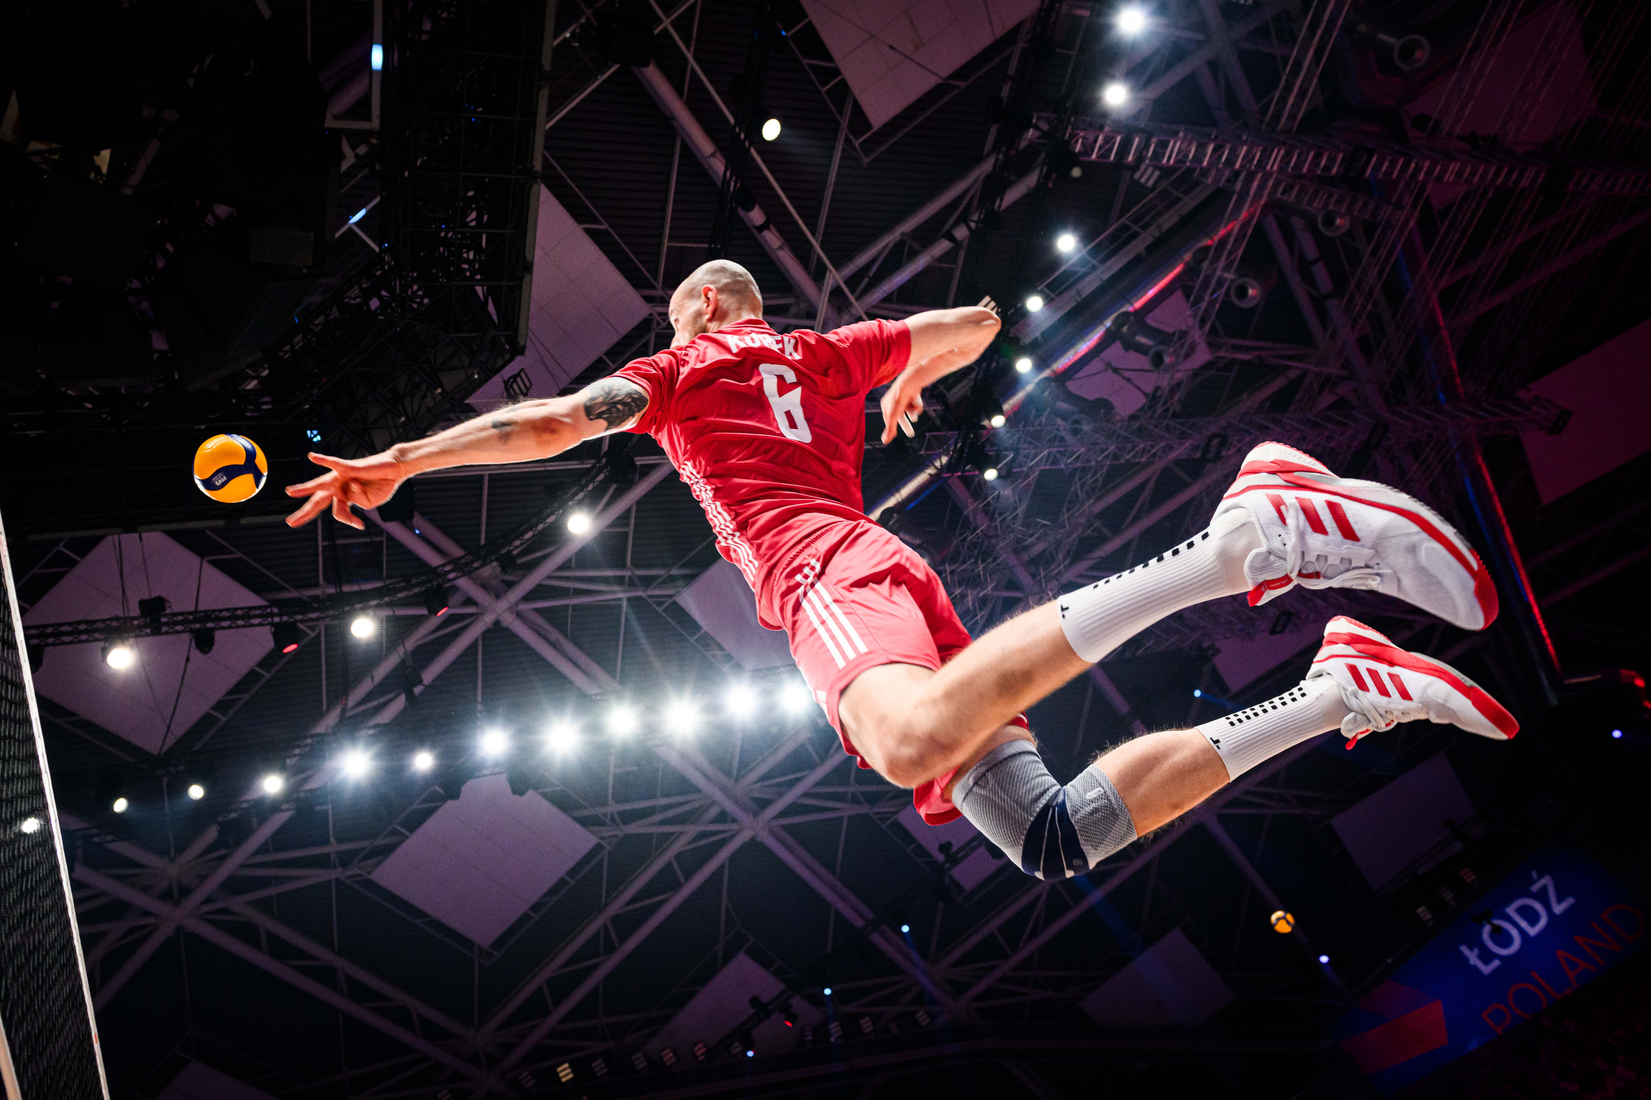
Questions?

