Slide 1

ECVA
2025 Referee Commission Report
Reginald R.M. Willemsberg

Slide 2

Program
ECVA Referee Commission
ECVA VB Championships 2025
International Referees
Virtual Referee Clinics
Registrations of Referees at the FIVB
Challenges
ECVA BVB Championships 2025
ECVA National BVB Referee Course 2025
ECVA referees 2023 – 2025 participation
Evaluation Referees
Recommendations

Slide 3

1. ECVA Referee Commission
ECVA Referee Commission Chairman:
Reginald Willemsberg, Sint Maarten (member of the NORCECA Referee Commission)

Slide 4

2. ECVA VB Championships
Senior Men’s Final Four held in John’s, Antigua, 19 – 21 September 2025
Senior Women’s Final 4 held in St. John’s, Antigua, 26 – 28 September 2025
Men’s U-23 held in St. John’s, Antigua, 11 – 17 November 2025
Note: Mr. Brian Charles assisted with these tournaments.

Slide 5
3. ECVA BVB Championships
Senior Women’s/Men’s Championships held in Castries, St. Lucia, 2 – 4 May 2025
U-21 Women’s/Men’s Championships held in Basseterre, St. Kitts, 5 – 8 June 2025

Slide 6
4. ECVA BVB National Referee Course
ECVA National Beach Volleyball Referee Course, Frigate Bay, St. Kitts 4 – 8 June 2025
  Instructors:
    Brian Hiebert
    Kenneth Waugh
  Participants
    10 NFs
    17 national referees
    Gender W 5 and M 12
    5 experienced BVB referees 1 CIC and 4 IR

Slide 7
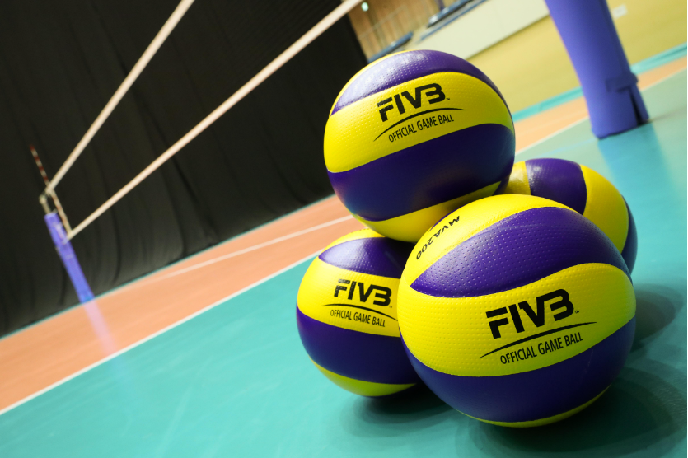



5. Referees of ECVA
Notes:
In the CAZOVA there are both referees for Volleyball and Beach Volleyball. Volleyball: Two (2) FIVB International Referees, Ten (10) International Referees and Three (3) Continental Referee Candidates.

Slide 8
List of Continental Candidate, International and FIVB referees within the ECVA
COUNTRY | NAME | Gender | CATEGORY | Retirement year
International Referees
St. Vincent & the Grenadines (VIN) | Duane Daniel | Male | International | 2029
Sint Maarten (SXM) | Servani Eckersly | Male | International | 2034
St. Lucia (LCA) | Shirlon Jeria-Hunte | Female | International | 2027

Slide 9
List of Continental Candidate, International and FIVB referees within the ECVA
COUNTRY | NAME | Gender | CATEGORY | Retirement year
Continental Candidate Referee
Antigua & Barbuda (ANT) | Rawle Lee | Male | Continental Candidate | 2034
St. Eustatius (EUX) | Monique Martis | Female | Continental Candidate | 2060

Slide 10
List of Continental Candidate, International and FIVB referees within the ECVA
COUNTRY | NAME | Gender | CATEGORY | Retirement year
NO International Referee
Saba (SAB) | Does not have an International Referee
Anguilla (AGU) | Does not have an International Referee
Montserrat (MNT) | Does not have an International Referee
St. Kitts & Nevis (SKN) | Does not have an International Referee
Bermuda (BER) | Does not have an International Referee
Grenada (GRN) | Does not have an International Referee
Saint Martin (SMA) | Does not have an International Referee
British Virgin Island (IVB) | Does not have an International Referee
Notes:
The table here shows National Federations within CAZOVA which has neither an
International Referee or Continental Referee for Volleyball or Beach Volleyball:

Slide 11
List of Continental Candidate, International and FIVB referees within the ECVA
COUNTRY | NAME | Gender | CATEGORY | Retirement year
Non active International Referees
Dominica (DMA) | Marcus Blondell | Male | International | 2028
St. Lucia (LCA) | Terry Faisal | Male | International | 2035
St. Lucia (LCA) | Wendel Jn Baptiste | Male | International | 2025
St. Eustatius (EUX) | Alex Arndell | Male | International | 2028

Slide 12
6. Internationals referees of ECVA
Beach Volleyball
ECVA REFEREE RANKING FOR BEACH VOLLEYBALL
National Affiliate | NAME | GENDER | CATEGORY
St. Kitts & Nevis (SKN) | Kemroy Percival | Male | Continental
St. Kitts & Nevis (SKN) | Rogol Mills-Costoso | Male | Continental
St. Lucia (LCA) | Keam Charlery | Male | FIVB International
St. Lucia (LCA) | Elvin Germain | Male | FIVB International
Dominica (DMA) | Julian Seraphine | Male | FIVB International
Antigua & Barbuda (ANT) | Henry Matthew | Male | Continental
Antigua & Barbuda (ANT) | Micheal Hamilton | Male | Continental Candidate
Notes:
Beach Volleyball: One (1) International Referee and Two (2) Continental Referee
Candidates:

Slide 13

7. Virtual Referee Clinics
IN 2025, the ECVA Referee Commission has organized Virtual Referee Clinics via the MS Teams environment to ensure assigned referees arrive better prepared to officiate in tournaments.
This was introduced because having a clinic locally before the tournament begins is not feasible due to time constraints
The virtual clinic was also conducted before the VB Senior Tournaments and was conducted by R. Willemsberg and B. Charles.

Slide 14

8. Challenges
Although the registration of referees has improved, we still see that some NFs are not in full compliance. This takes away the opportunity for regional national referees to be eligible to participate in international VB/BVB referee courses.
Since 2023, the referee commission has ensured that all referees participating in the tournaments are registered by reviewing the submitted R-1 forms. In case the referee is not registered, the respective NFs are contacted to rectify the situation. (See the next slide for a copy of registered referees who have participated in the tournaments in 2023 and 2024.)
Not enough development possibilities for the region
Lack of initiative by the individual referees to keep up with the theory
Lack of practical experience in active IRs, Continental IRs, and Continental IRCs.
Not enough chances for ECVA referees to be able to work in tournaments.
  This can be improved with referee/referee coach exchanges between zones ECVA and CAZOVA
Challenge for succession ECVA Referee Commission.
Local Referee Participation: local referees often face additional burdens and distractions when not fully integrated into tournament accommodations, impacting their focus and the sense of team cohesion.

Slide 15
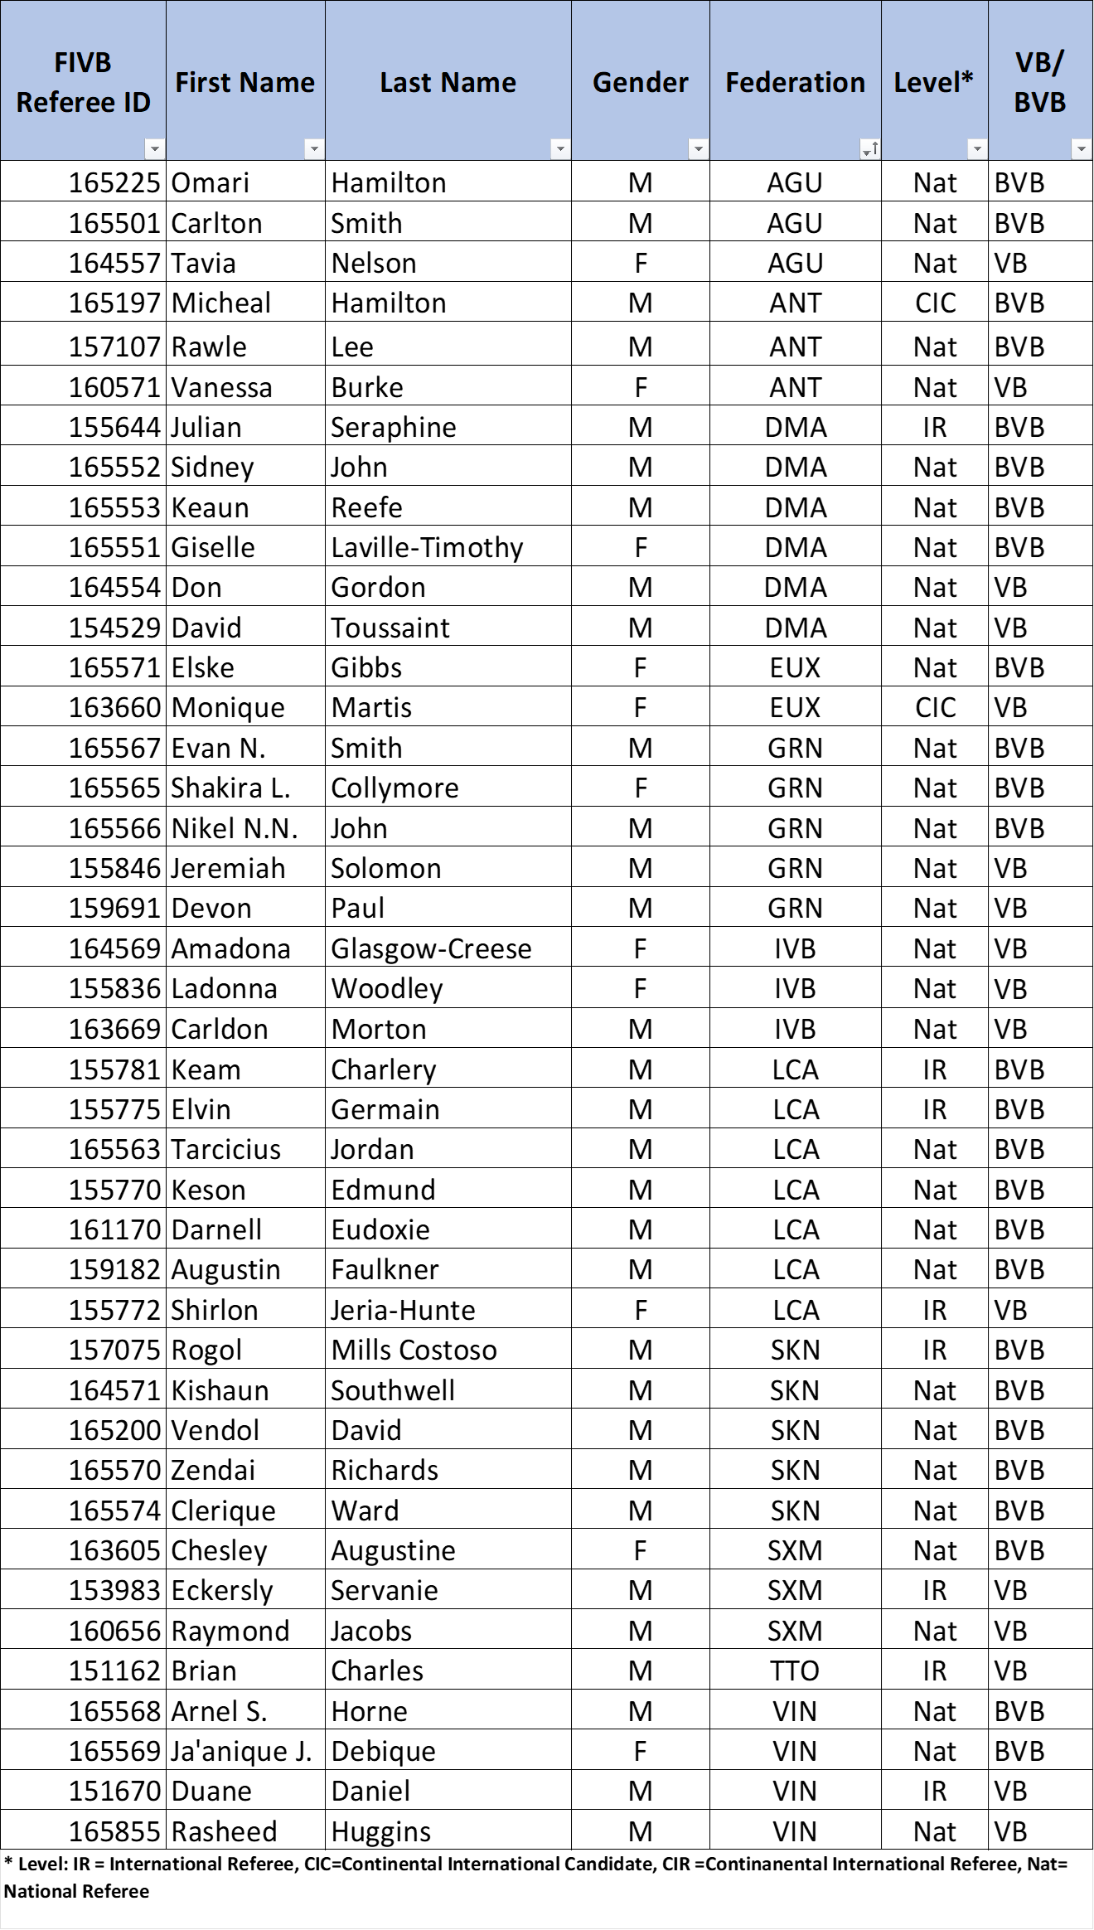
9. ECVA Referees 2023 – 2025 participation

Slide 16
10. Evaluation Referees
Referees demonstrated growth and eagerness to learn
Continued preparation and structured training are essential
ECVA Referee Commission should prioritize clinics and mentorship to build consistency and confidence

Slide 17
11. Recommendations
Referees should participate in virtual and practical clinics
Referees should focus on confidence, decisiveness, and proper signaling
Continuous Study and Application: Referees are urged to continue reviewing the
latest rule book, guidelines, and case studies, emphasizing that understanding and
correctly interpreting the official materials is crucial for effective officiating.
Knowledge Sharing and Mentorship: Referees are encouraged to pass on
their experiences and insights to colleagues, players, and coaches, fostering a
more informed volleyball community and supporting the development of future
referees.
Setting Aspirations and Succession Planning: Referees are advised to set high
goals, such as aiming for continental or international certification, and to step
aside or mentor others if they are no longer eligible for advancement, ensuring the
growth of the referee pool.

Slide 18
11. Recommendations continued
Self-Analysis and Constructive Criticism: the importance of self-analysis of referees and accepting constructive criticism, recommending that referees engage in post-match reviews and discussions to identify strengths and areas for improvement.
Per Diem: National federations have to adhere per diem as stated in the tournament regulations
Local Referee Participation: National federations are urged to ensure that the local referees are integrated into tournament accommodations, resulting in improved focus and team cohesion.
Early arrival of referees before the start of the tournament should be continued because it makes it possible to have face to face clinics and practical sessions to help hone the skills of the referees
Maintaining a Consistent Referee Pool: ECVA should continue to work with a stable group of referees, rotating them across tournaments to build experience

Slide 19


